Slide 1
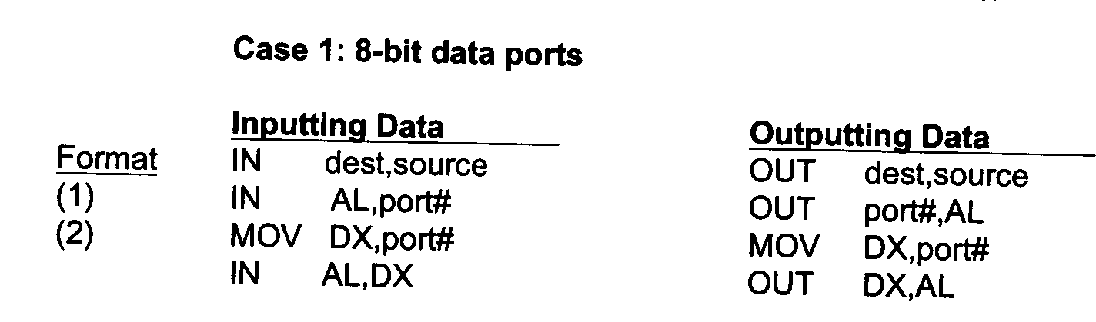
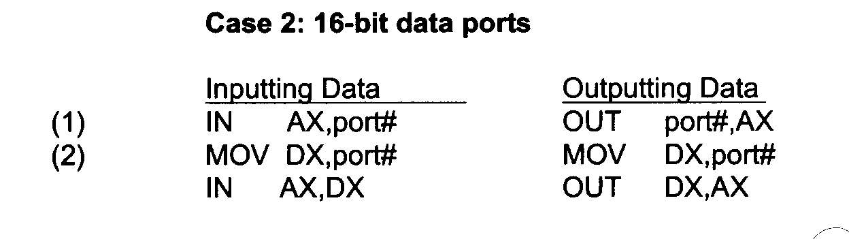
Port Mapped I/O

Slide 2
Port-Mapped vs Memory Mapped IO
With memory mapped I/O accesses to peripherals look like accesses to
memory.
With memory mapped I/O entire address bus needs to be decoded.
With memory mapped I/O no need for IOR* and IOW* signals
With memory mapped I/O no limit to number of peripherals other than
size of address bus.
With memory mapped I/O one can perform ALU ops directly on I/O data
without transferring them to a register first.
With memory mapped I/O processor instruction decoder is simpler
because you don’t have the IN and OUT instructions.
One problem with memory mapped I/O is that some of the address space
is used by the I/O devices.
Conclusion: Memory mapped I/O reduces H/W within processor while
port mapped I/O can reduce H/W on motherboard.

Slide 3
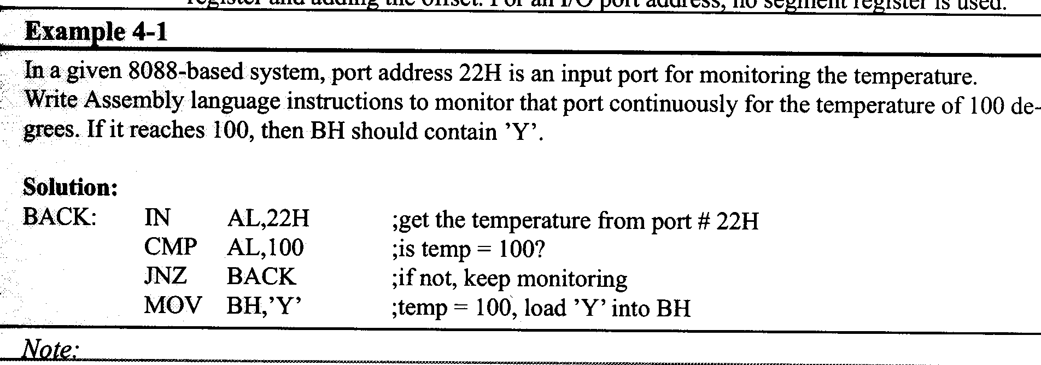
Port Example

Slide 4
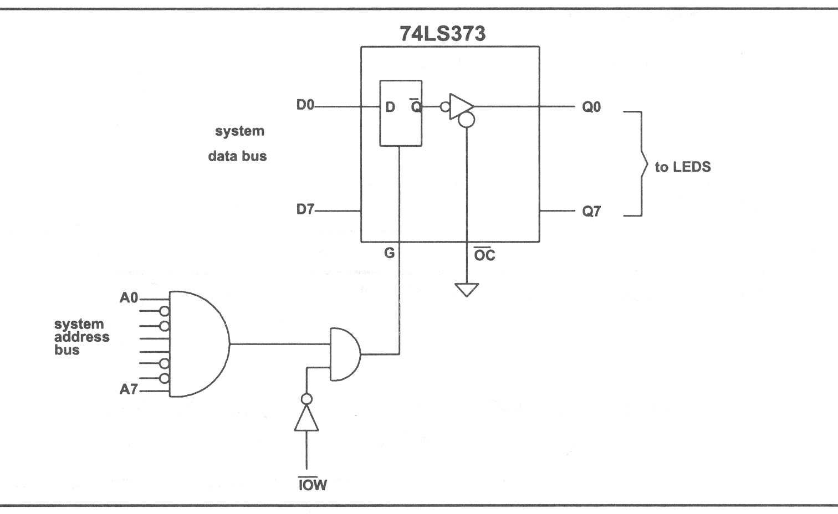
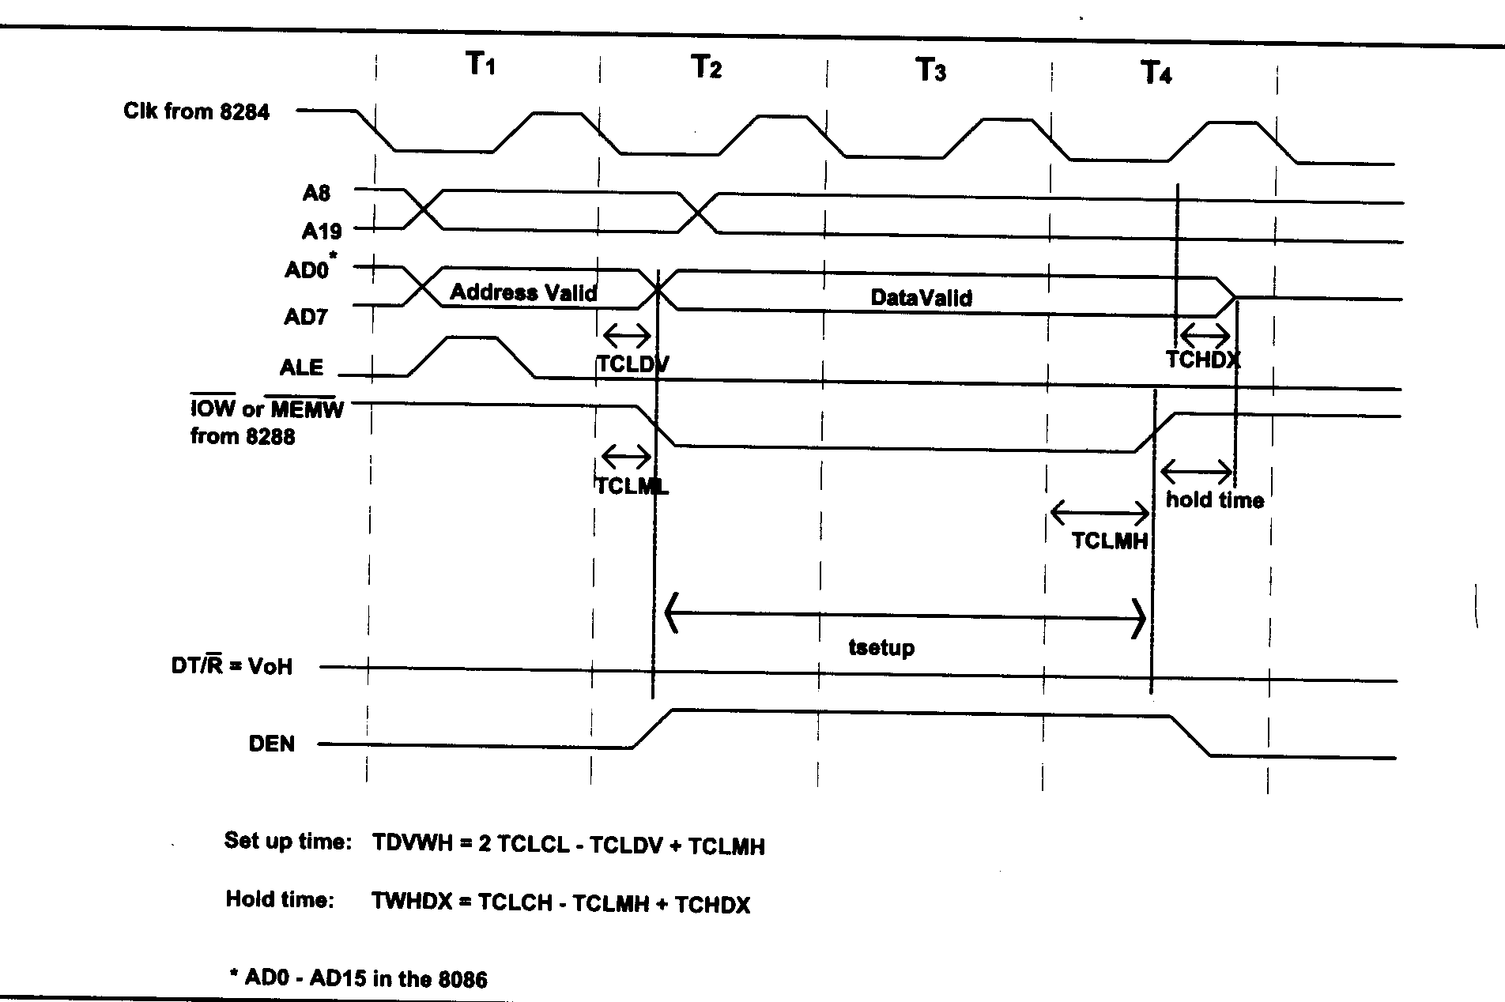
Adding 8-bit Output Port Using 74LS373 Latch

Slide 5
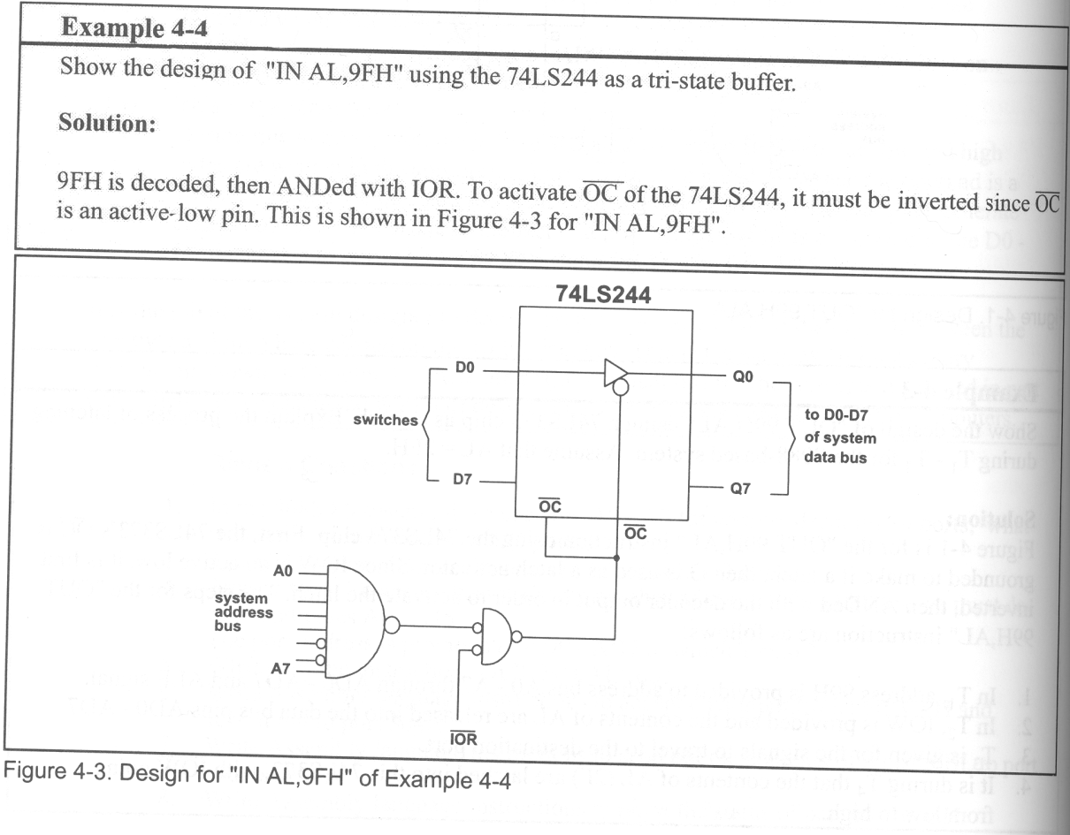
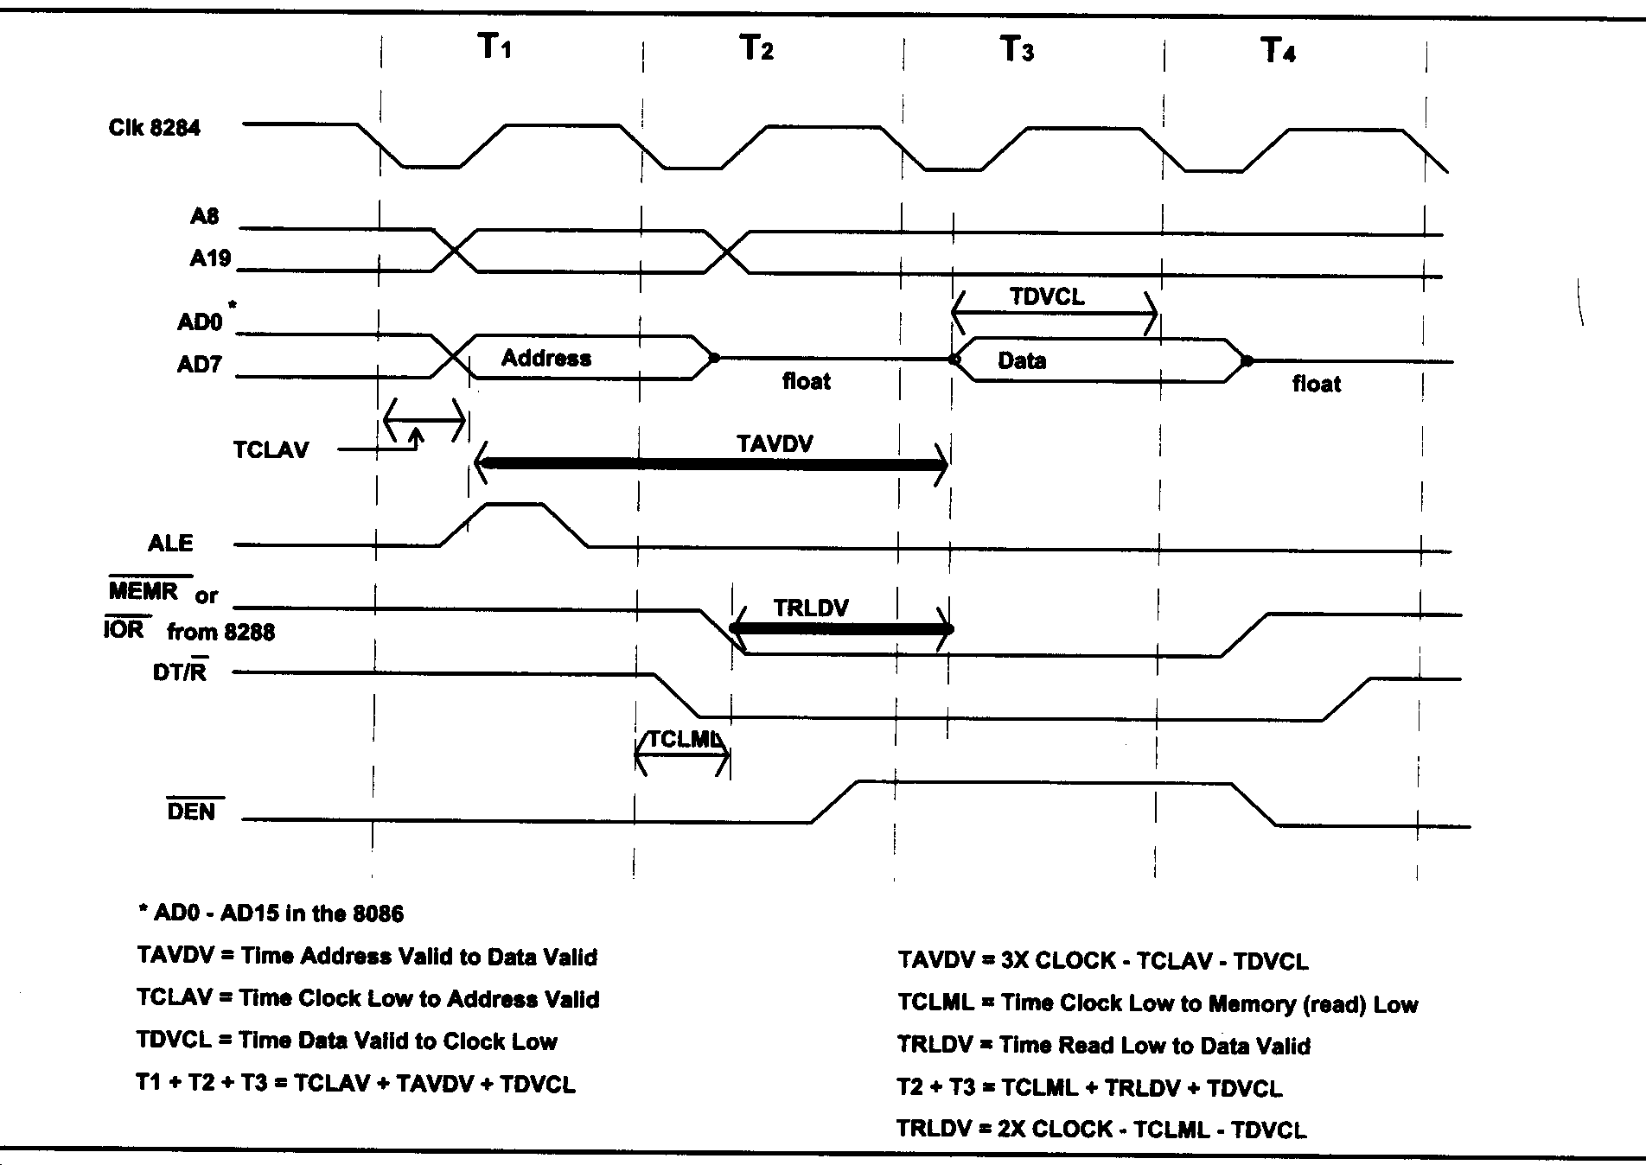
Adding 8-bit Input Port Using 74LS244

Slide 6
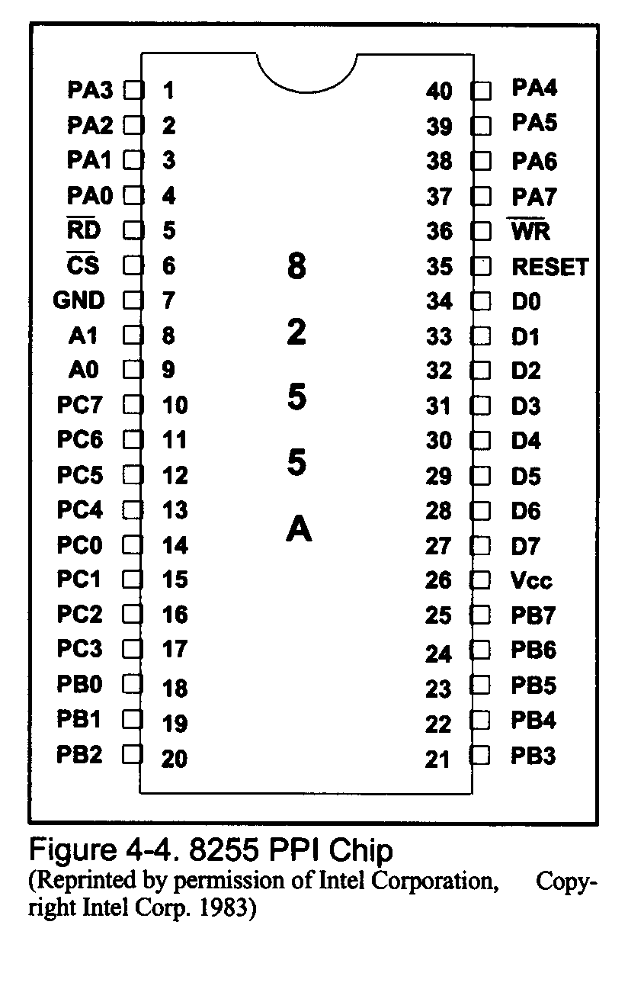
8255 PPI Chip Pinout

Slide 7
8255 A, B, C Ports
8255 generally more flexible and more economical than using
74LS373s and 74LS244s
A can be programmed as input or output port.
It can also be an 8-bit bidirectional port.
B also can be programmed as in input or output port.
It cannot be used as an 8-bit bi-directional port.
C can also be either an input or an output port.
Can be be split into two 4 bit ports. Each 4 bit port
can be either an input or an output port.
Also, bits of C port can be outputs and individually programmed.

Slide 8
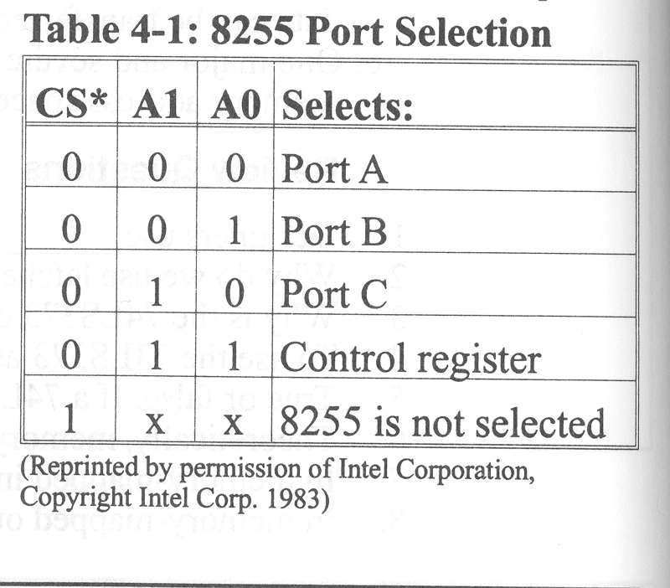
8255 Port Selection

Slide 9
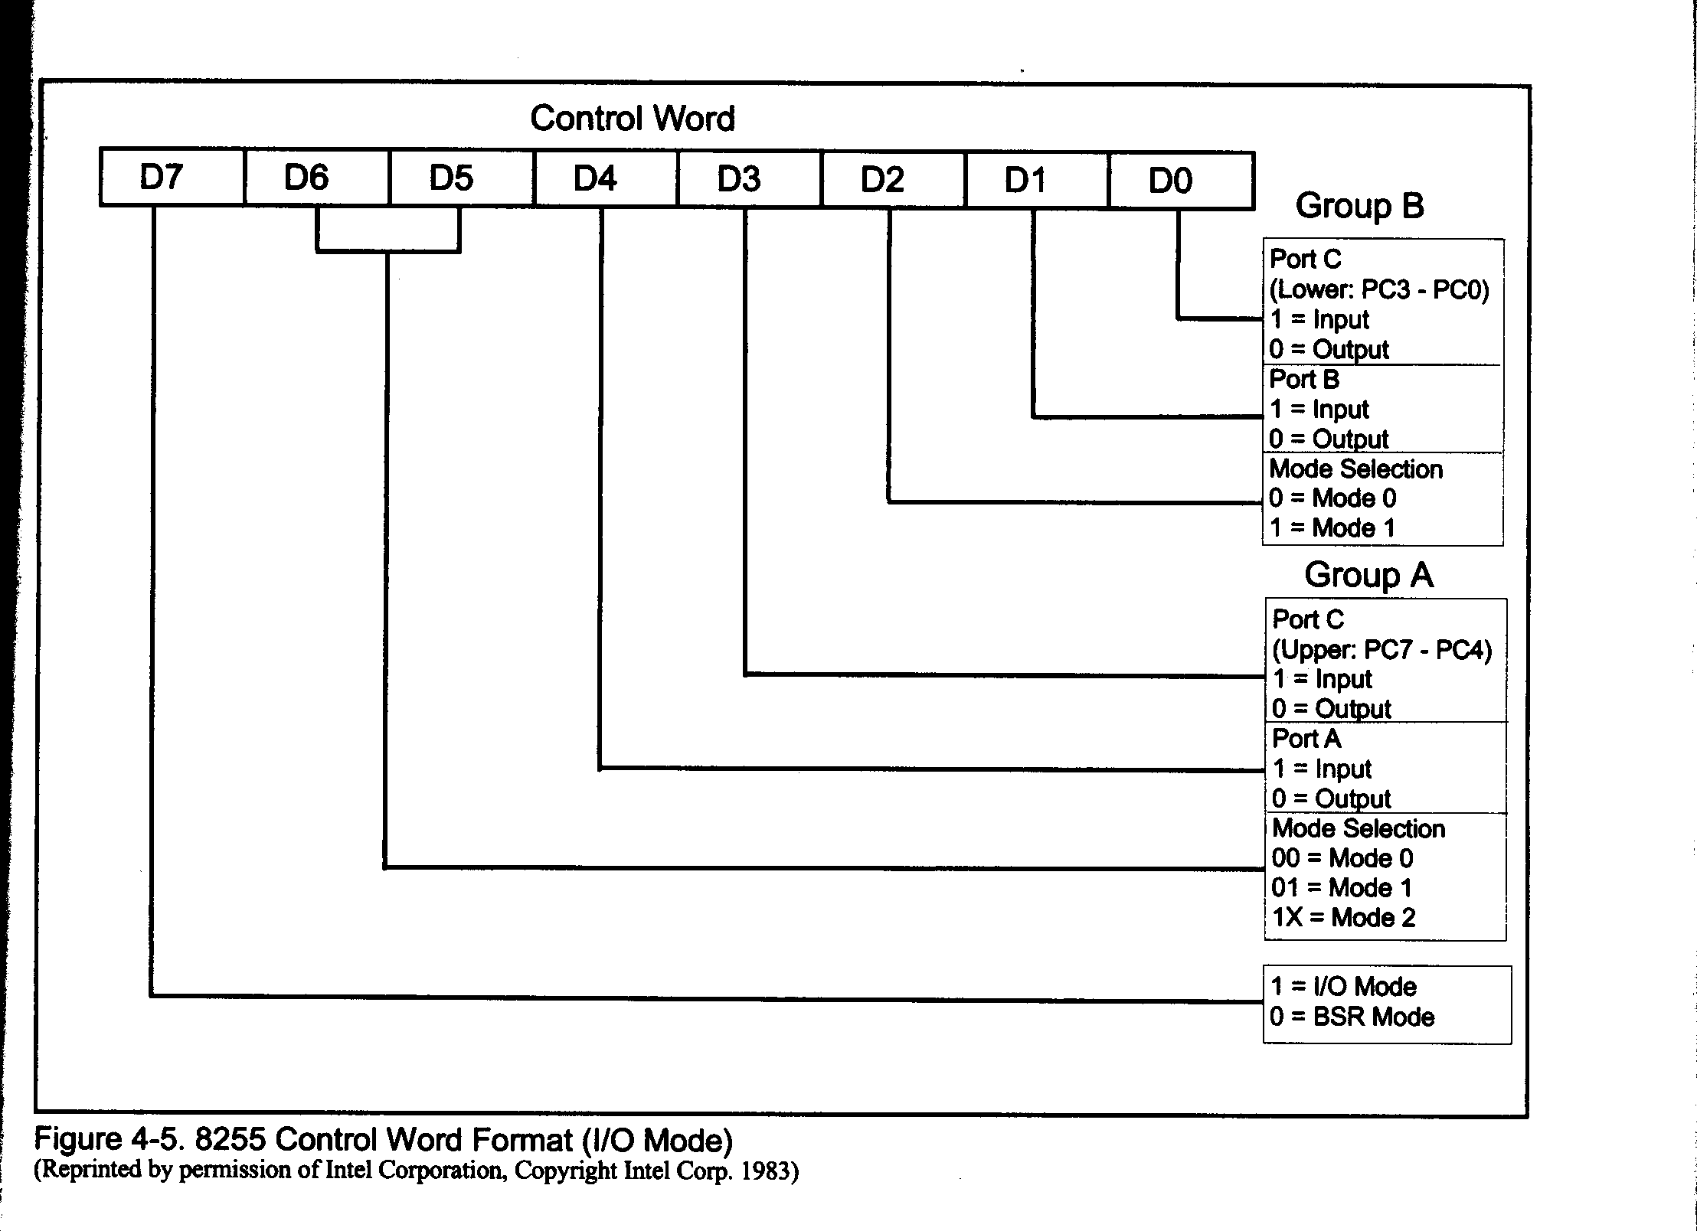
8255 Control Word

Slide 10
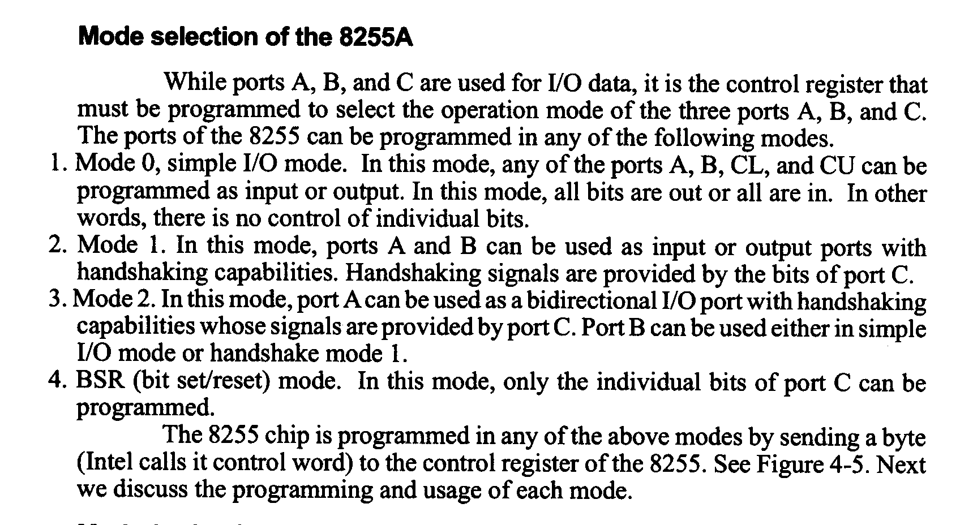
8255 Mode selection

Slide 11
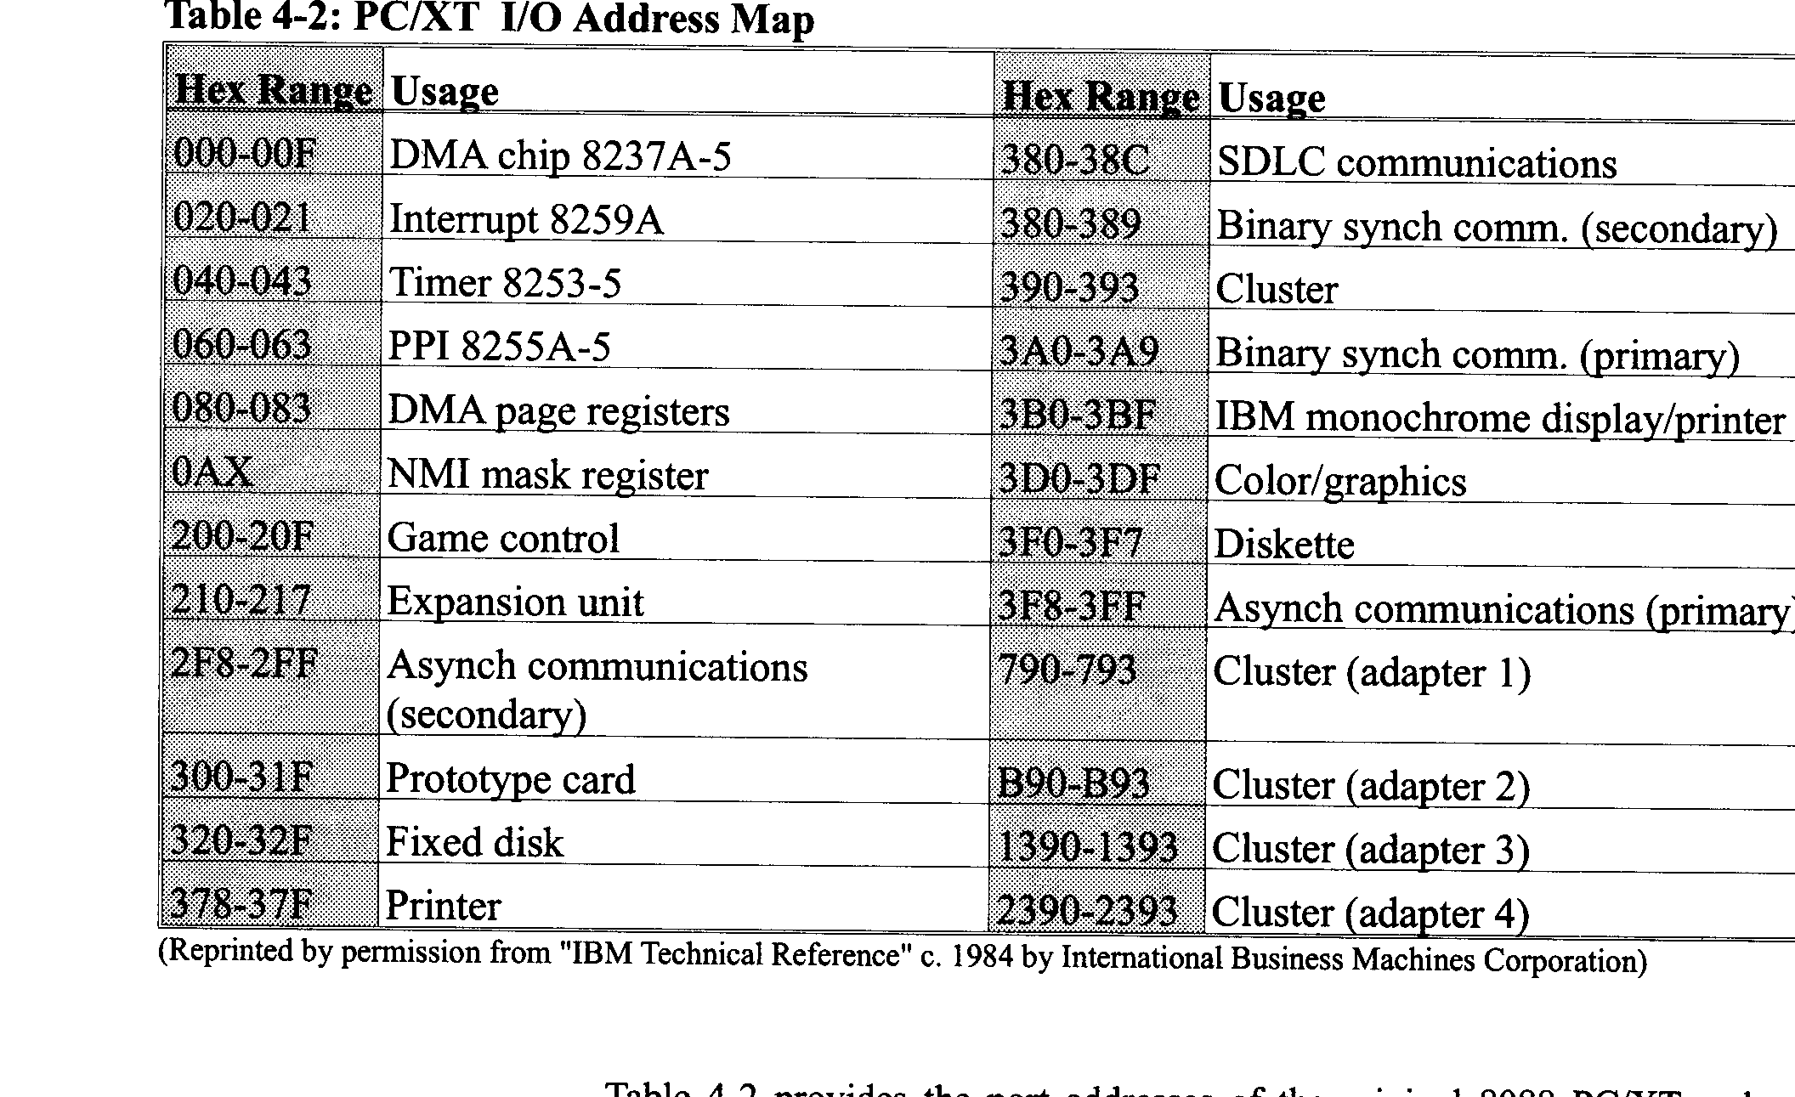
PC I/O Address Map

Slide 12
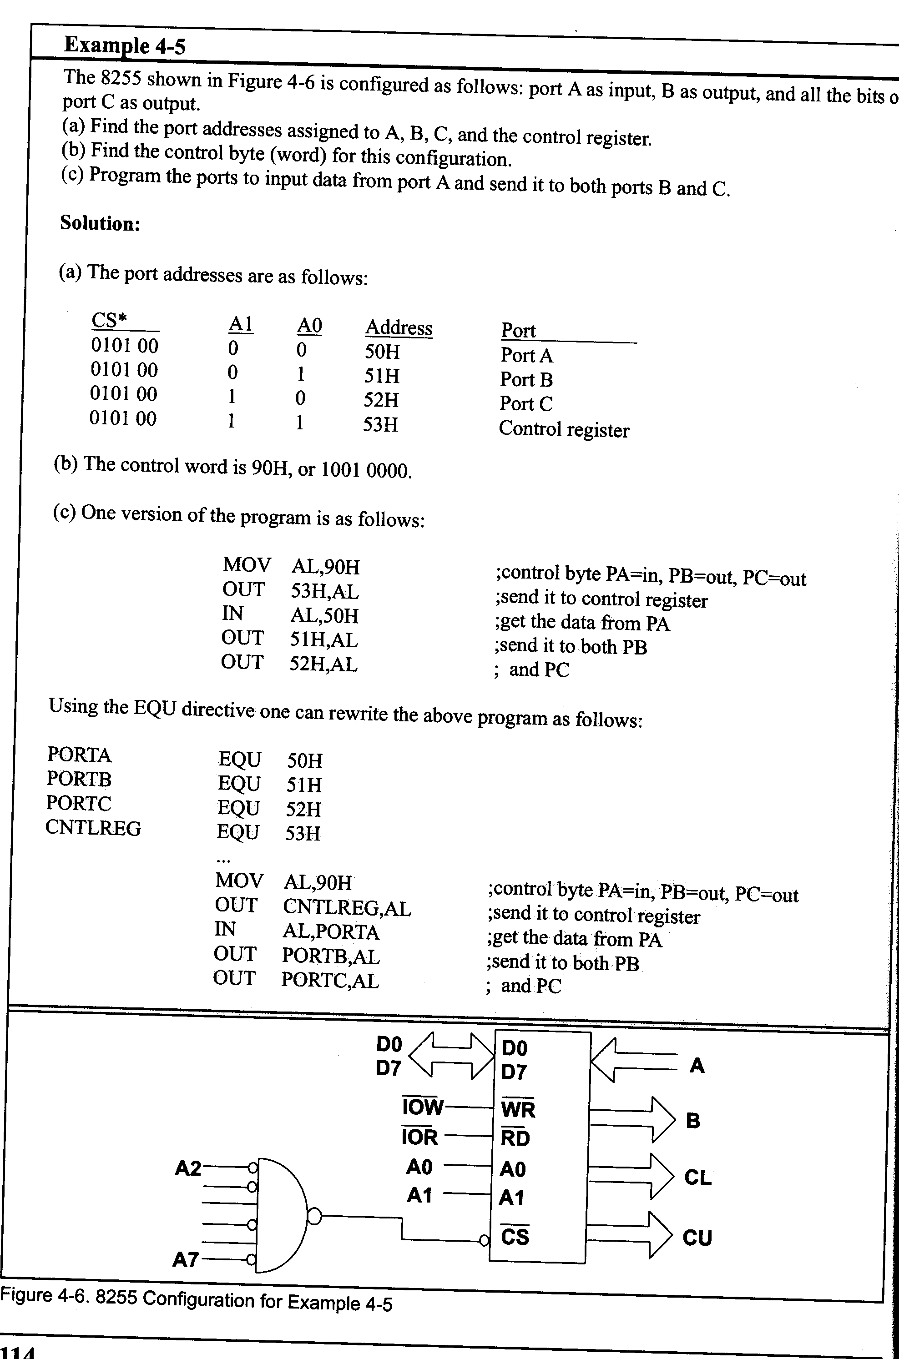
Example 4-5

Slide 13
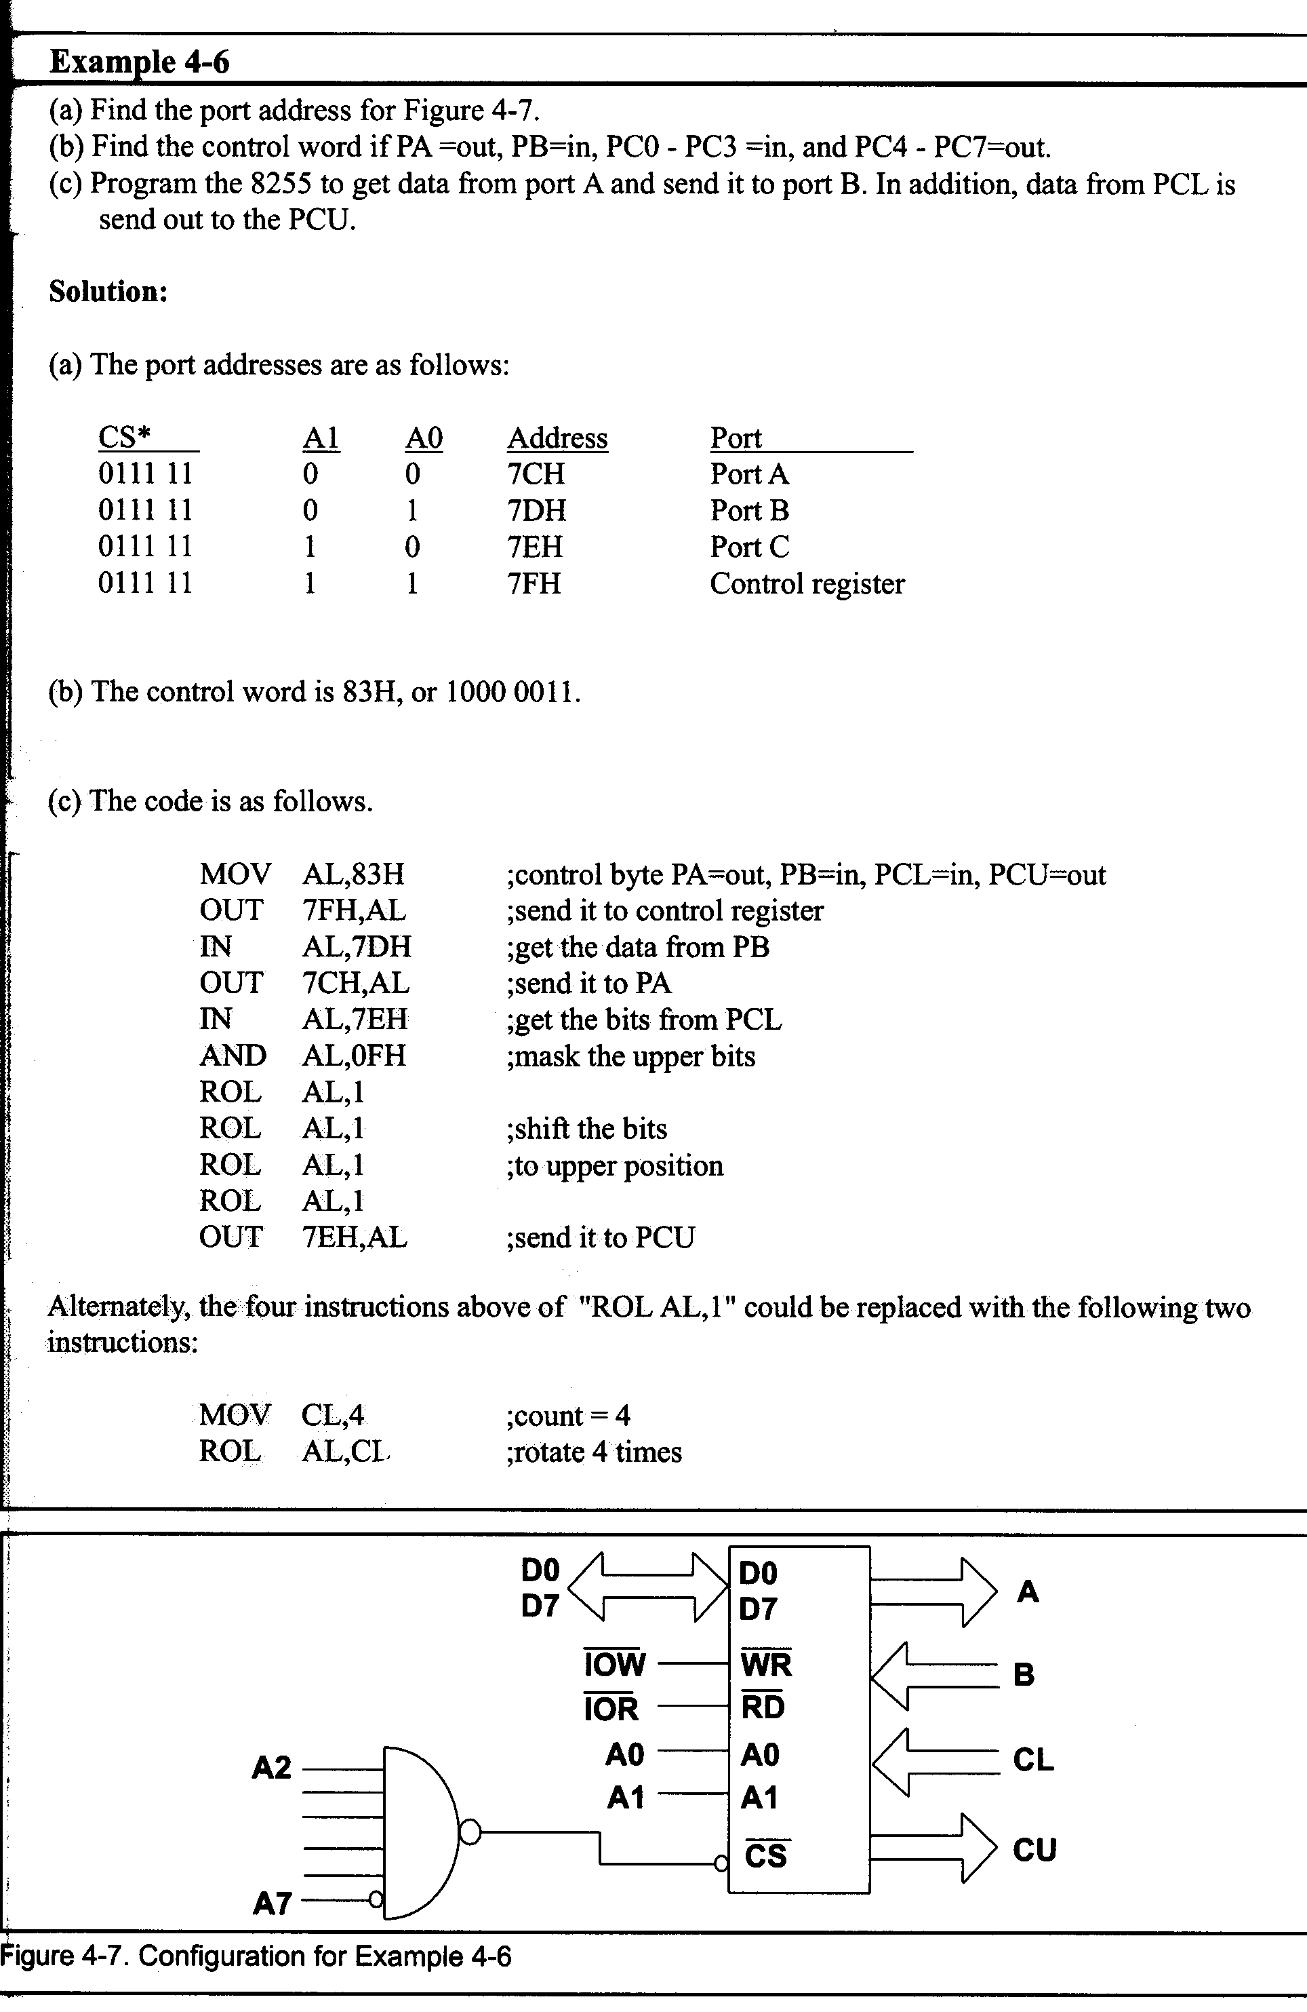
Example 4-6

Slide 14
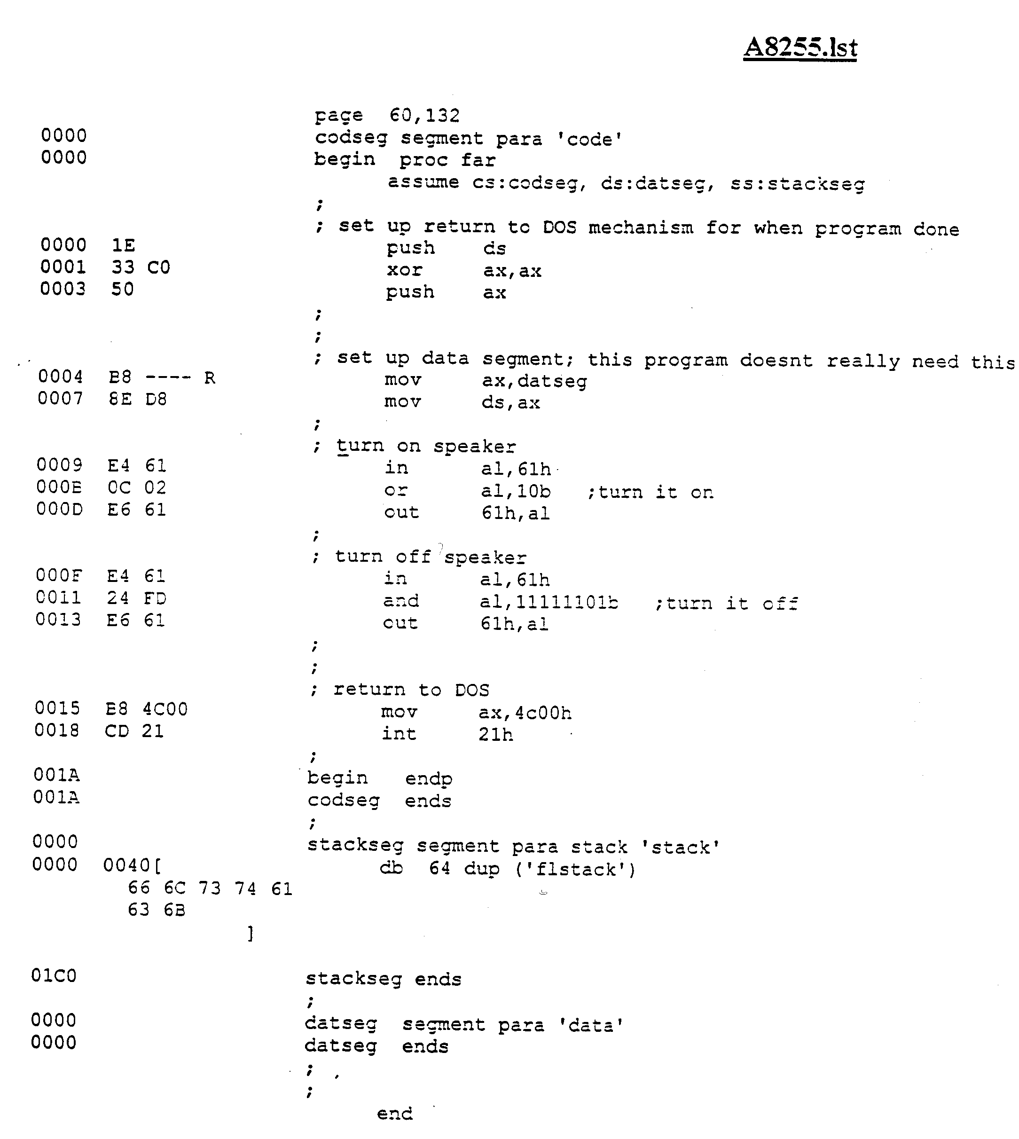
Lab 4 (A8255.lst)

Slide 15
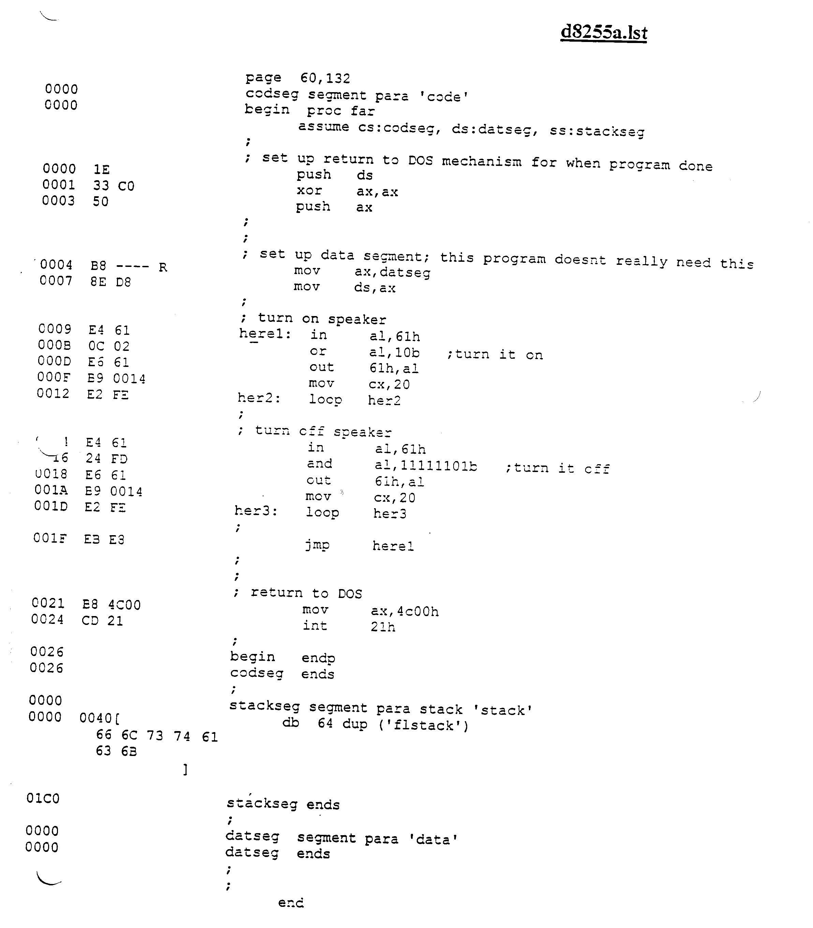
Lab 4 (d8255.lst)

Slide 16
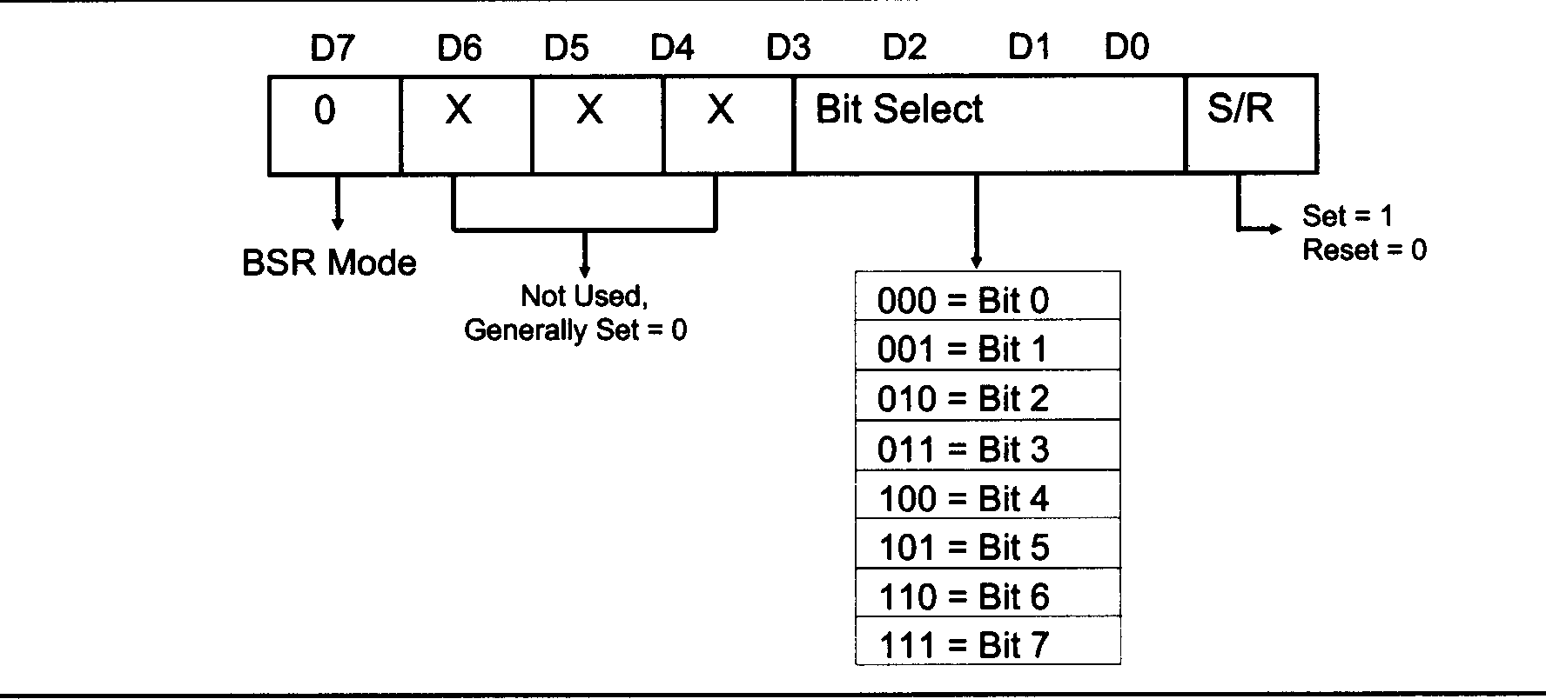
BSR Mode

Slide 17
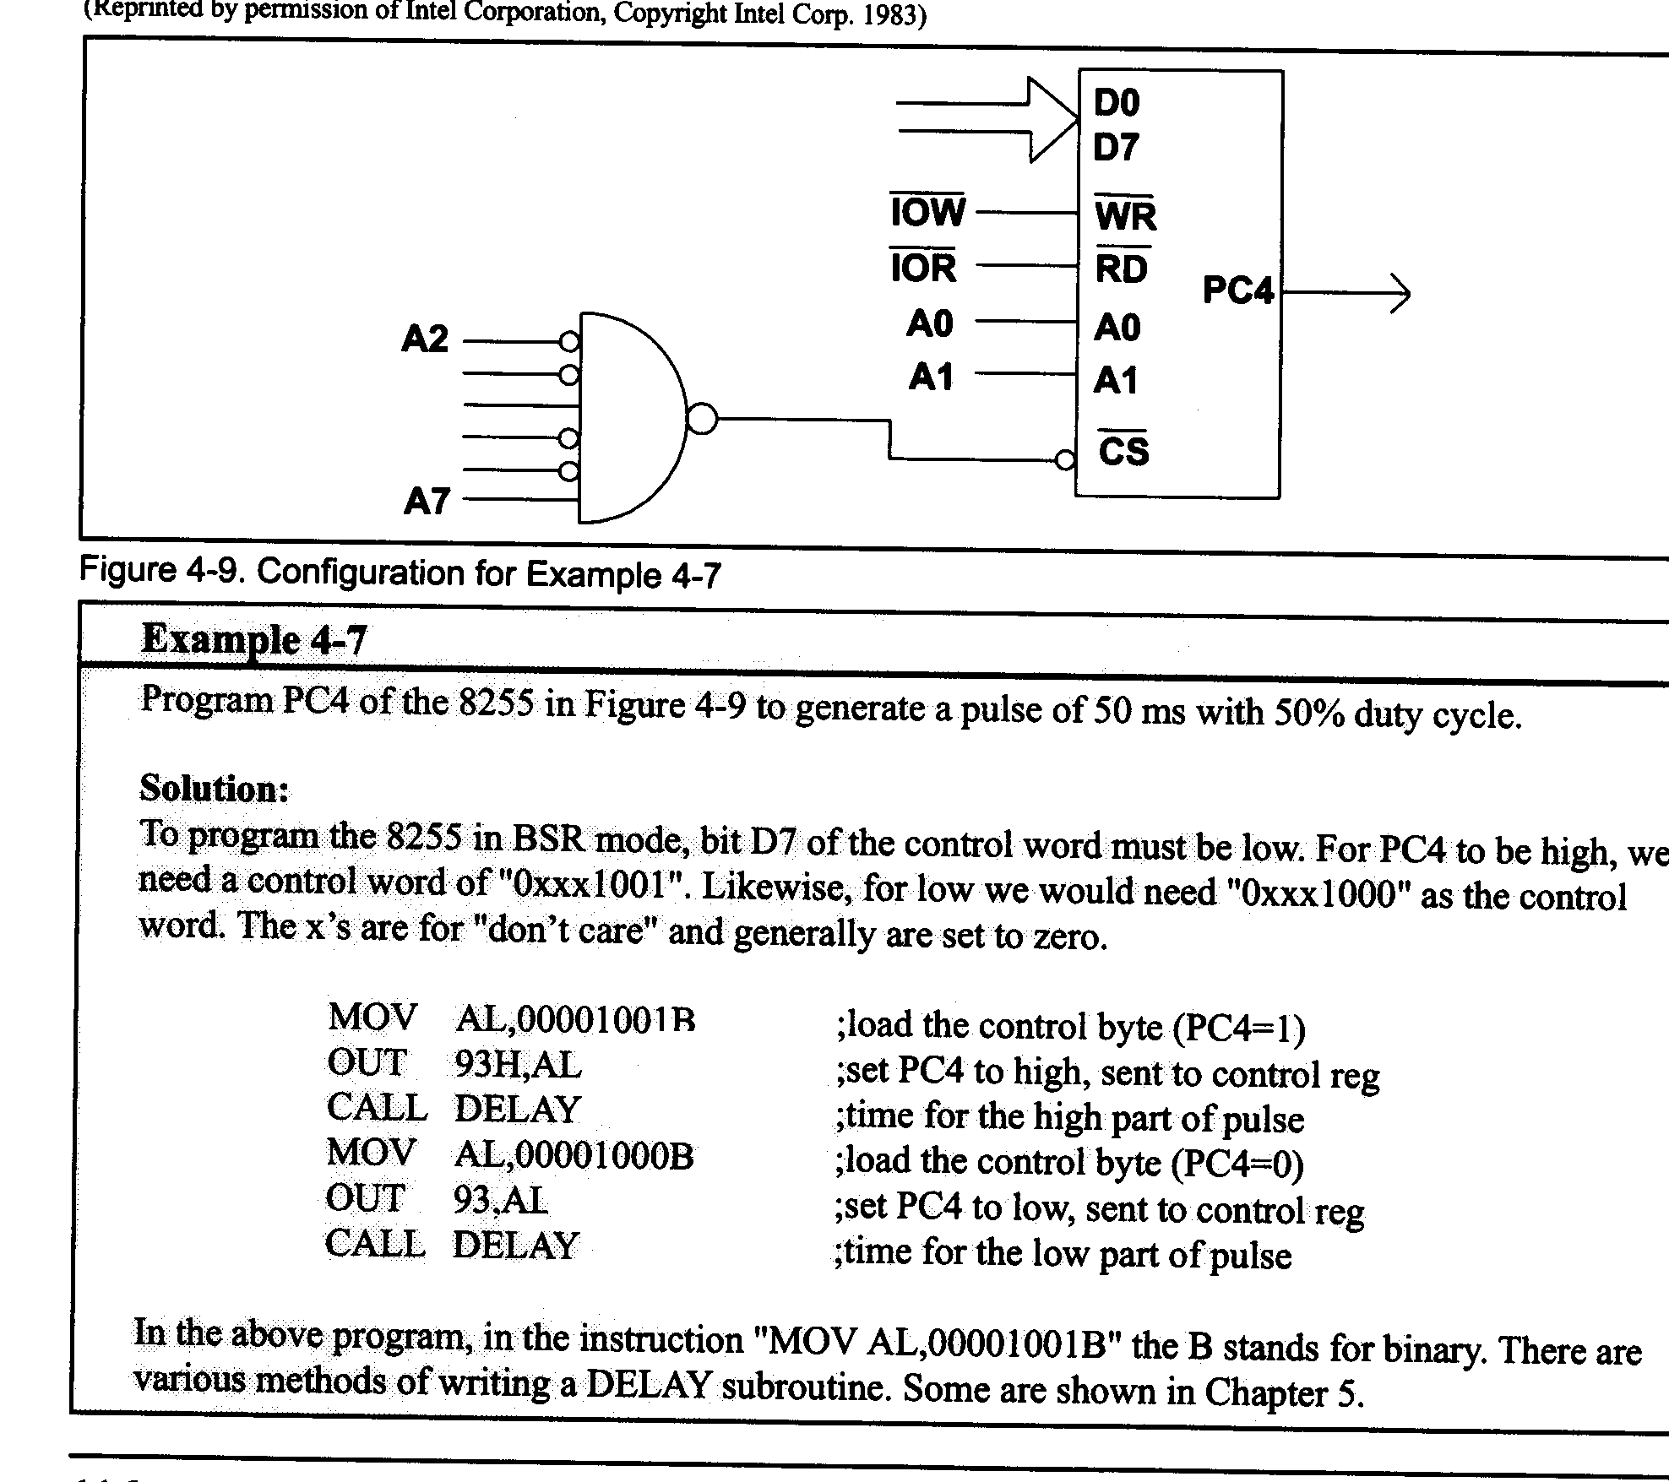
BSR Example 4.7

Slide 18
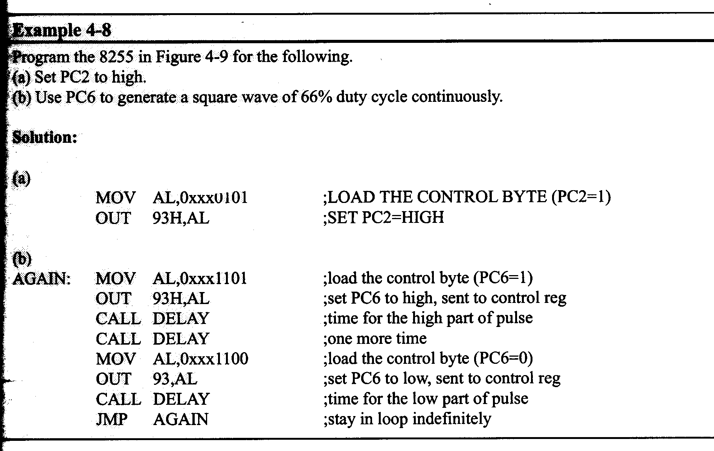
BSR Example 4.8

Slide 19
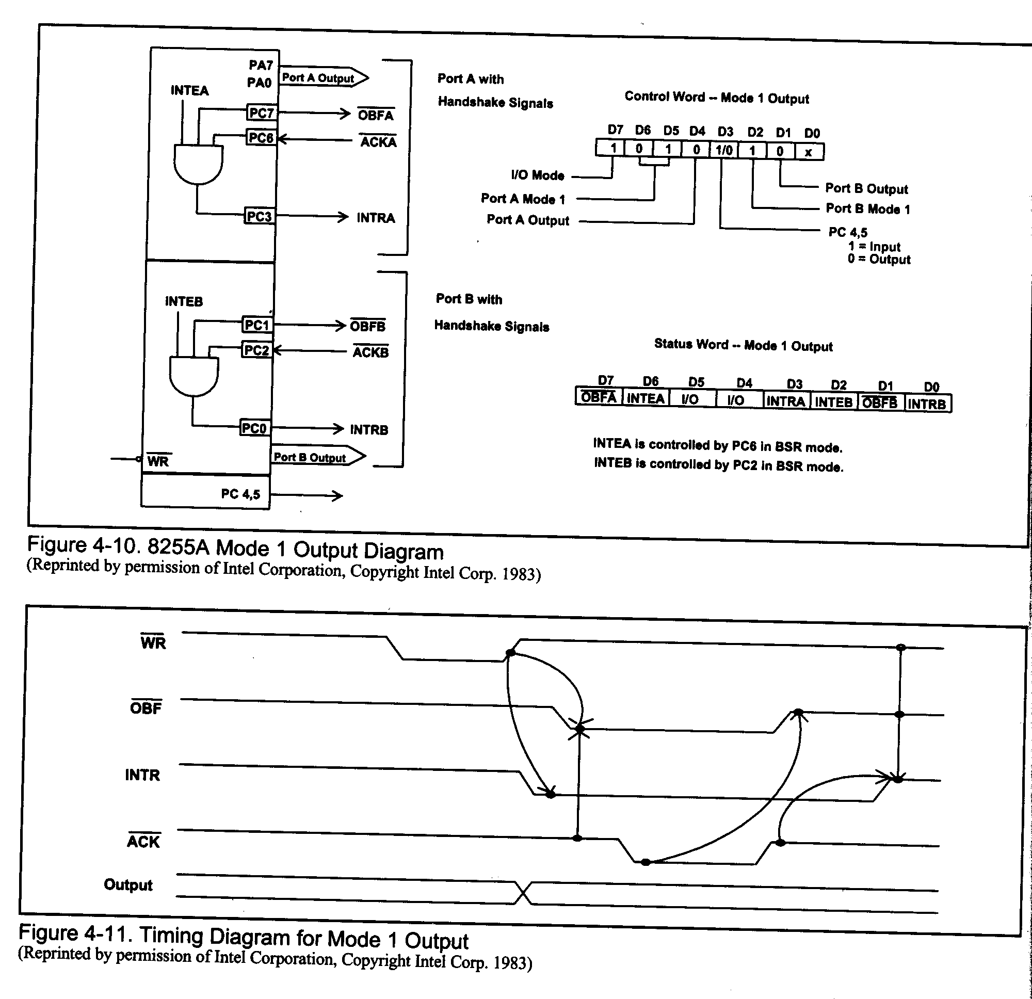
Handshaking

Slide 20
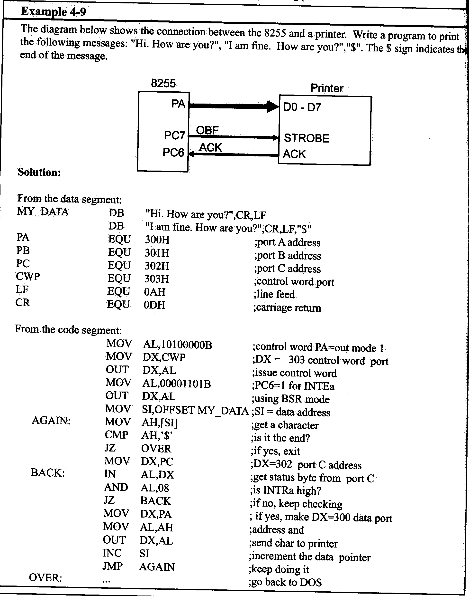
Talking to a printer

Slide 21
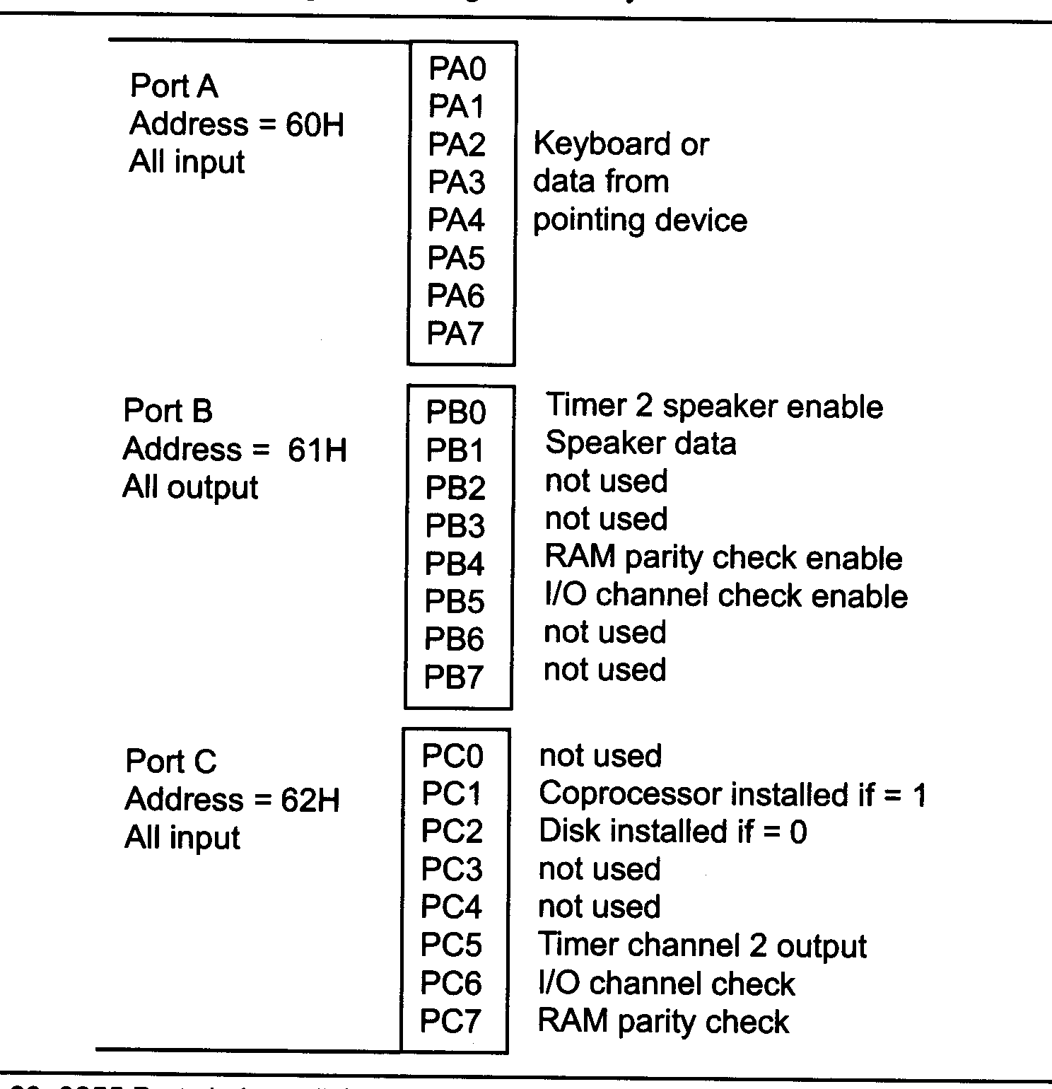
How the 8255 Ports are Used in a PC

Slide 22
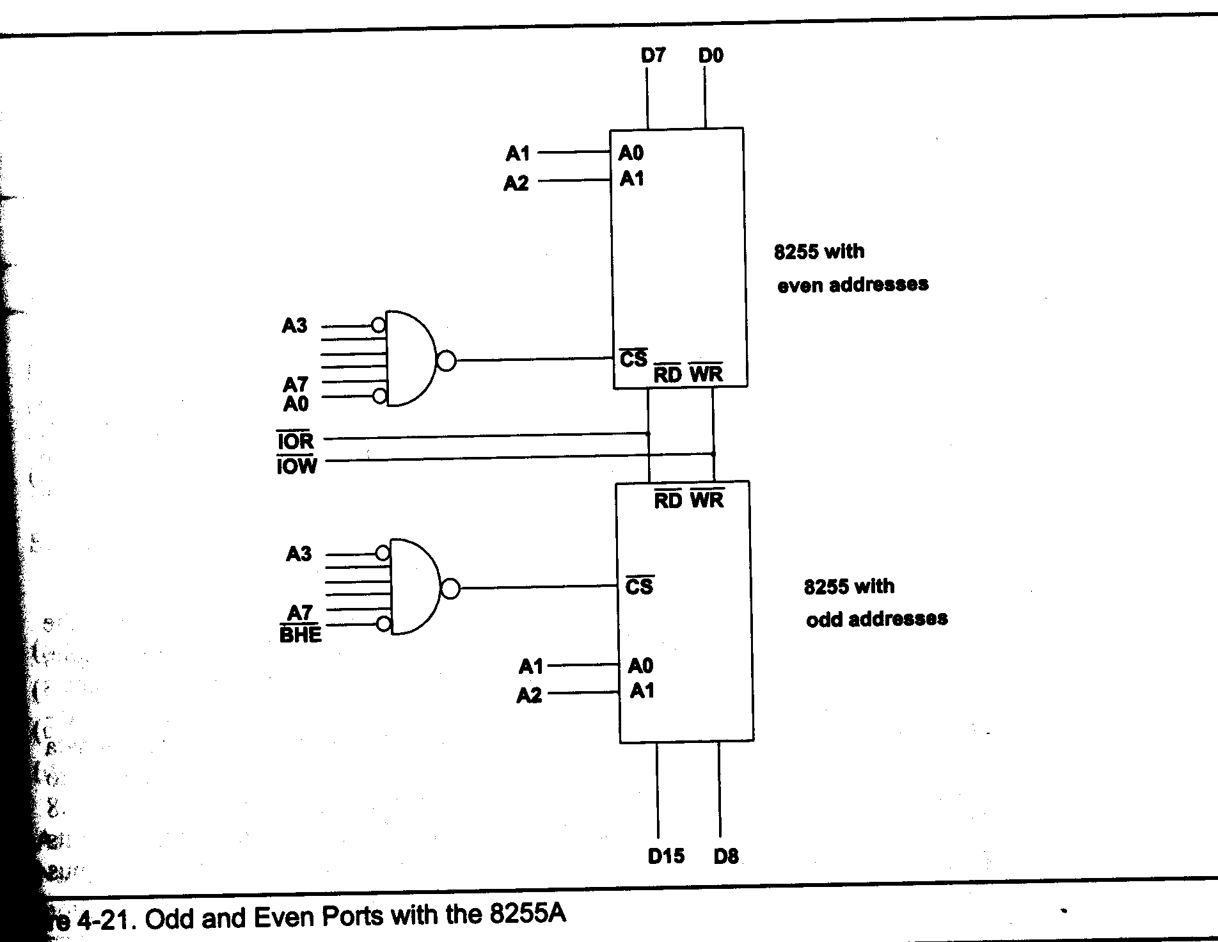
Odd and Even Ports With 8255

Slide 23
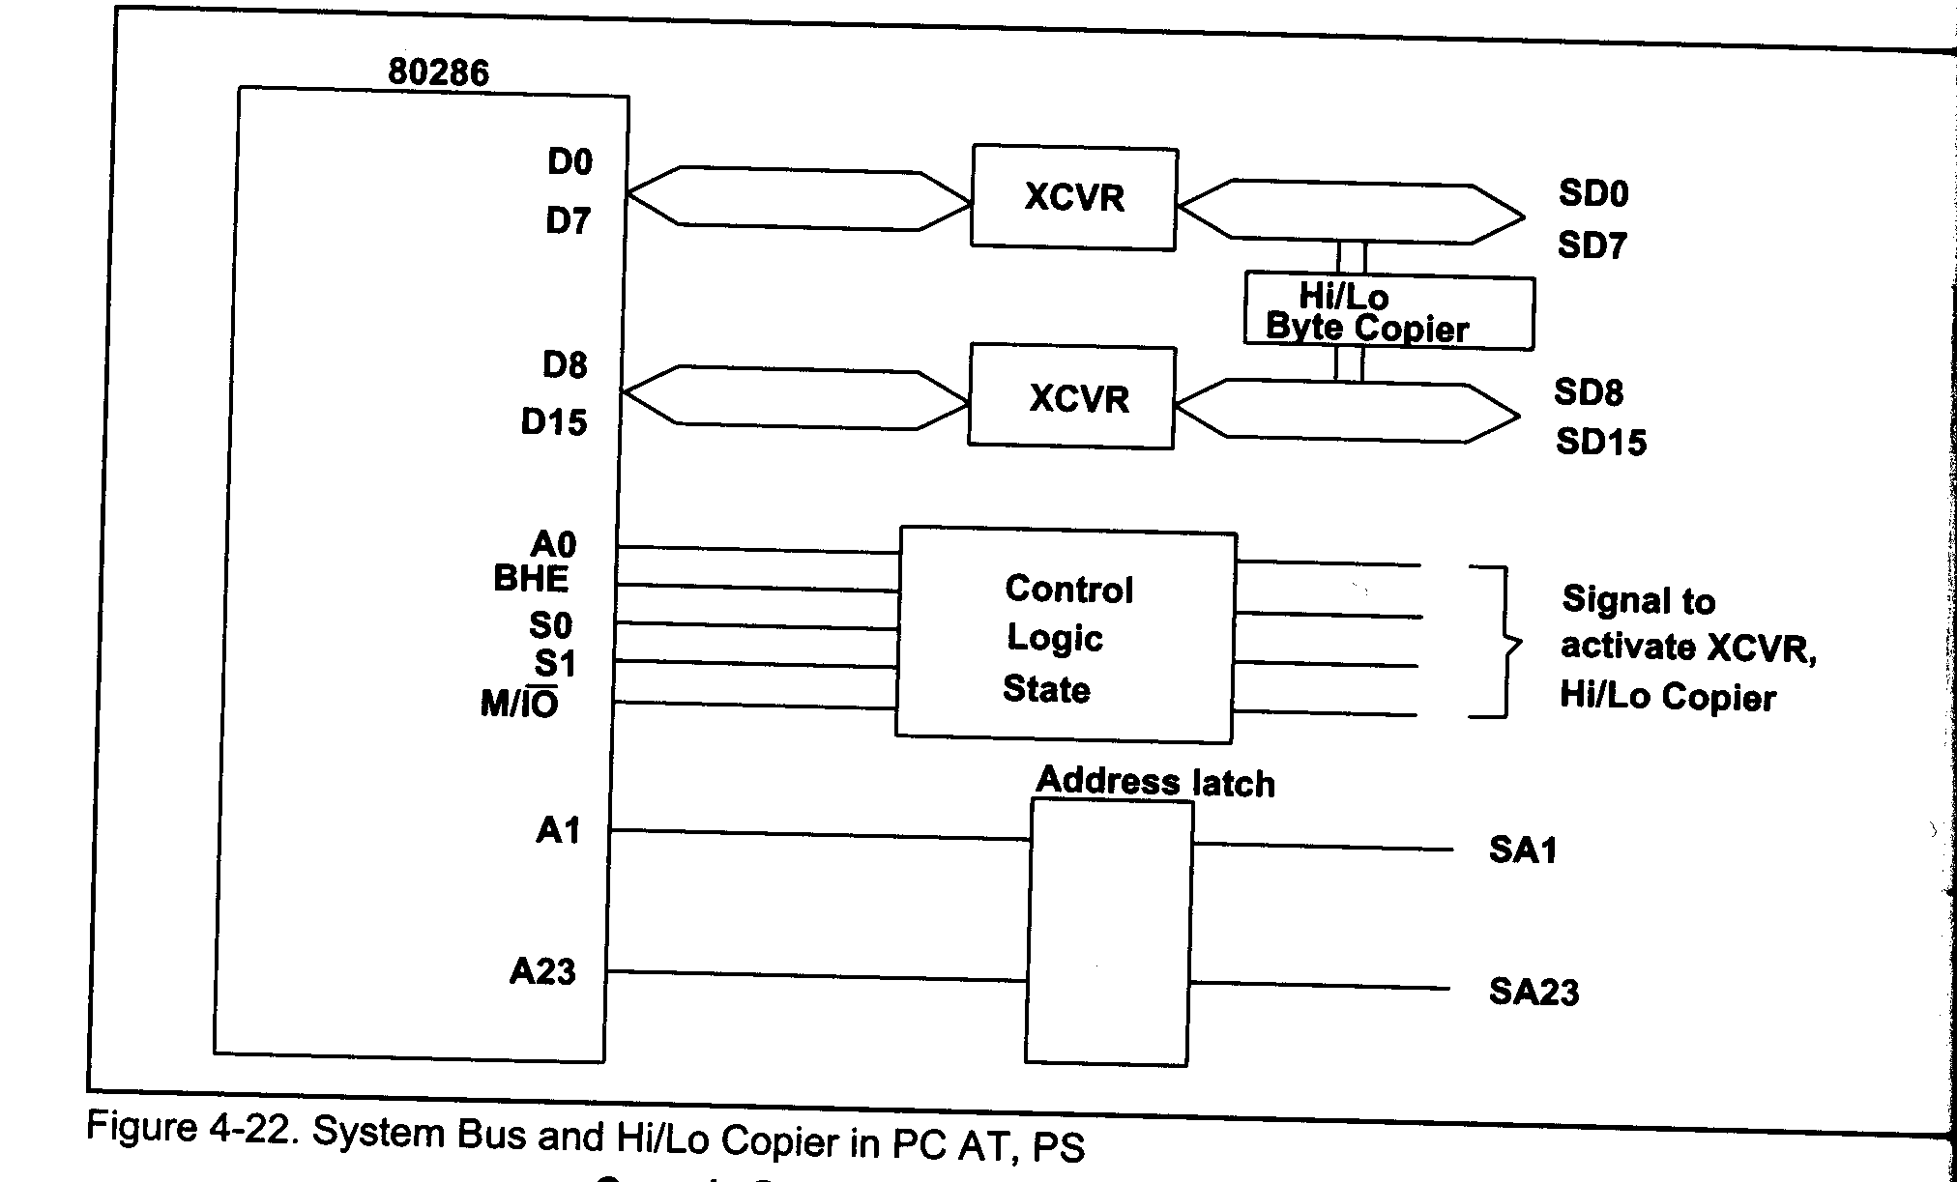
Hi/Lo Copier

Slide 24
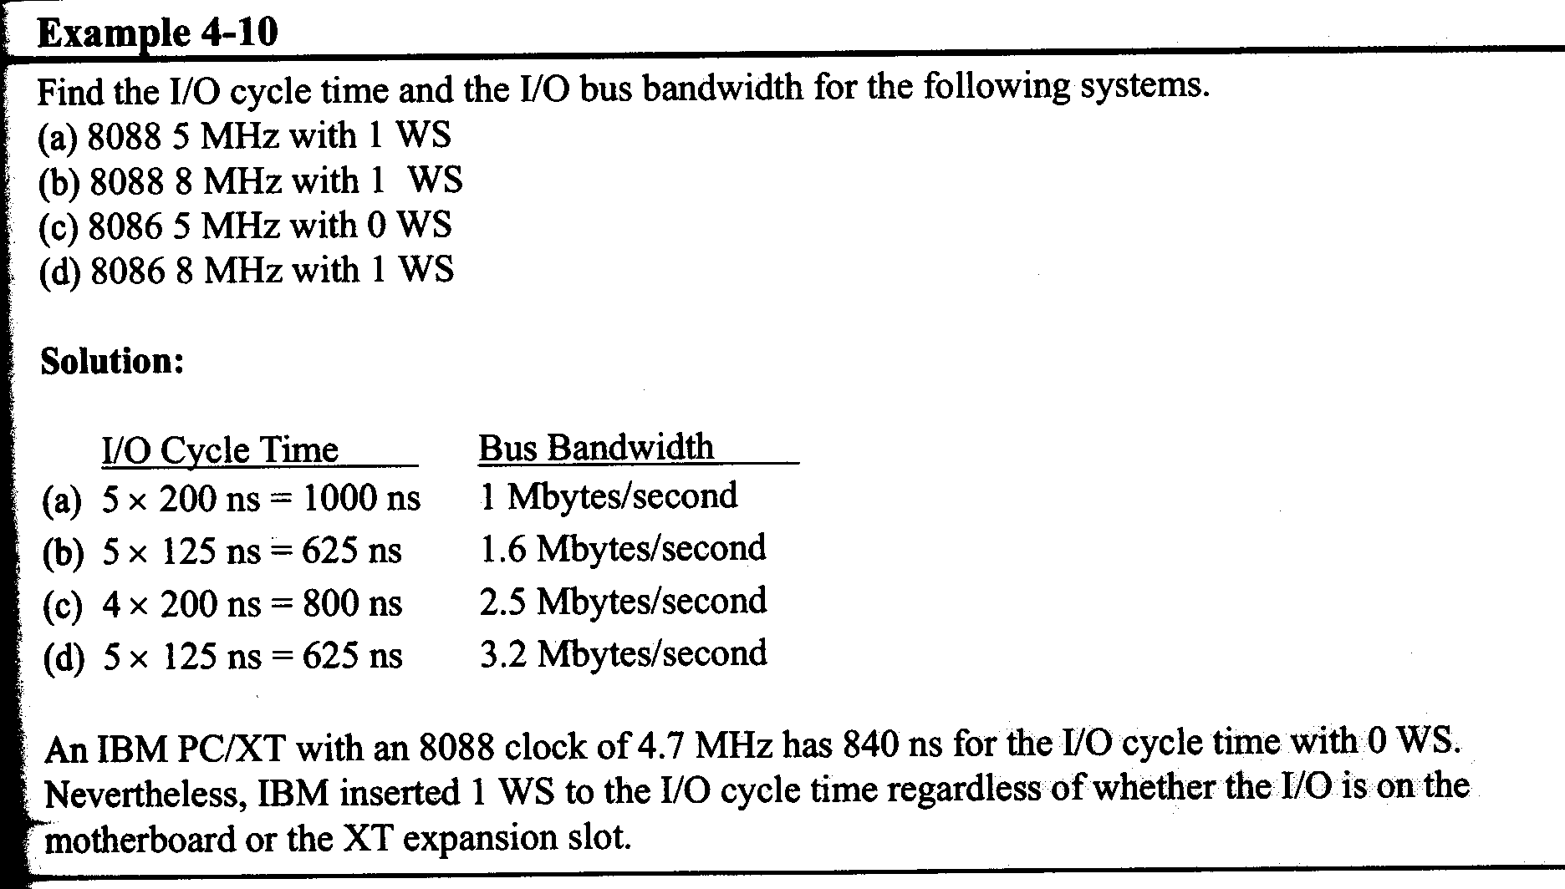
I/O Bandwidth

Slide 25
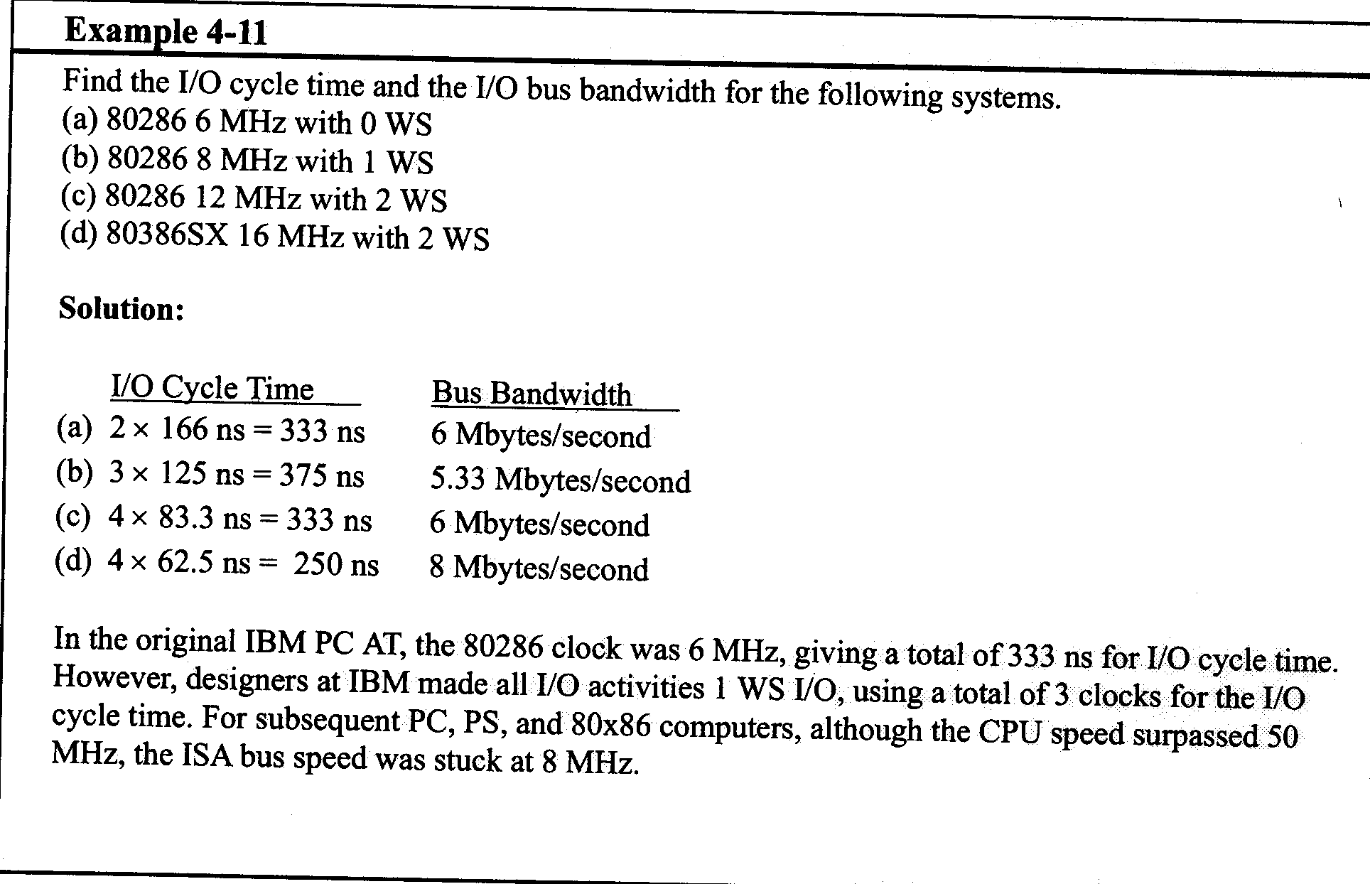
I/O Bandwidth (Slide 2)

Slide 26
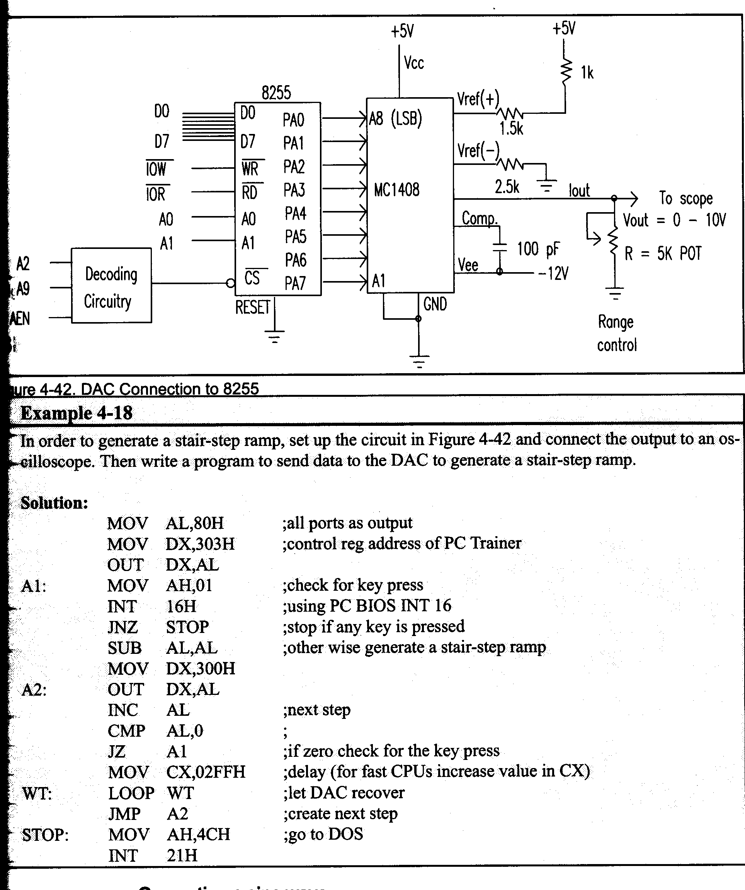
Interfacing a DAC to 8255

Slide 27
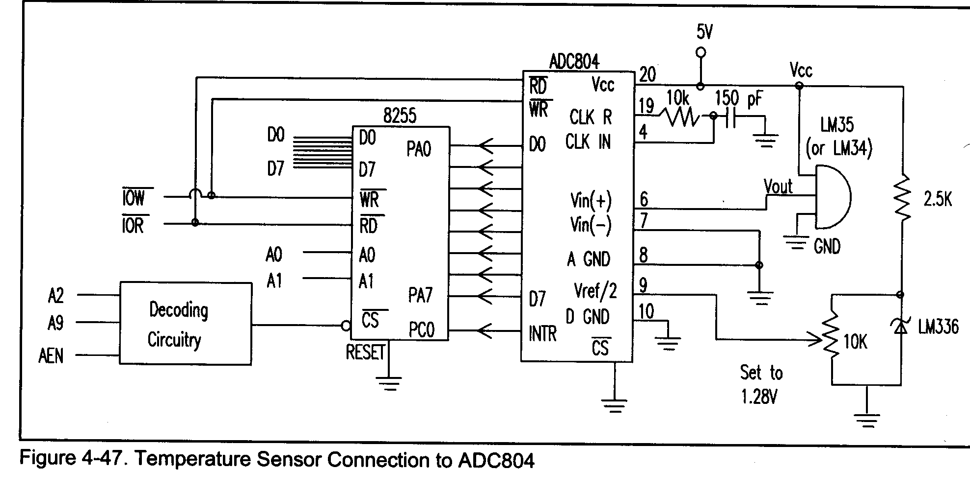
Design of a Digital Thermometer

Slide 28
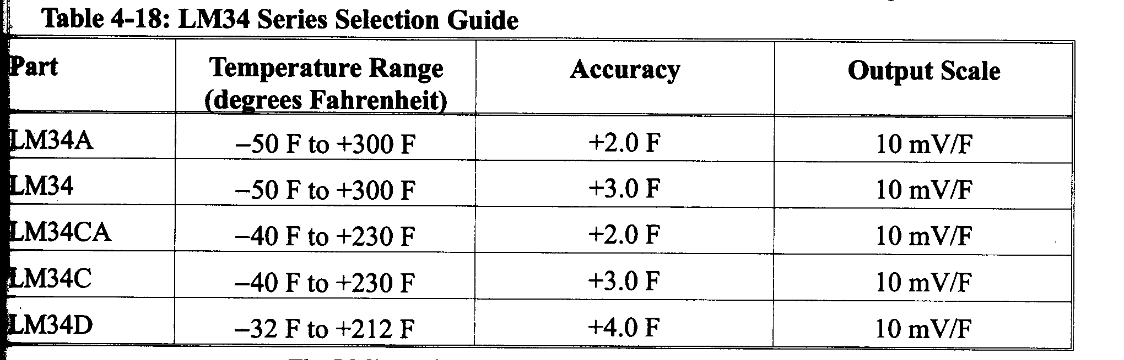
LM34 Thermometer IC

Slide 29
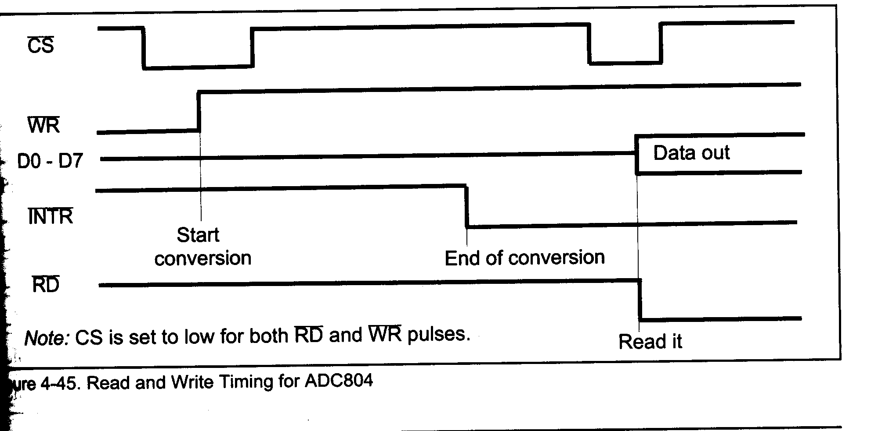
ADC804 Timing

Slide 30
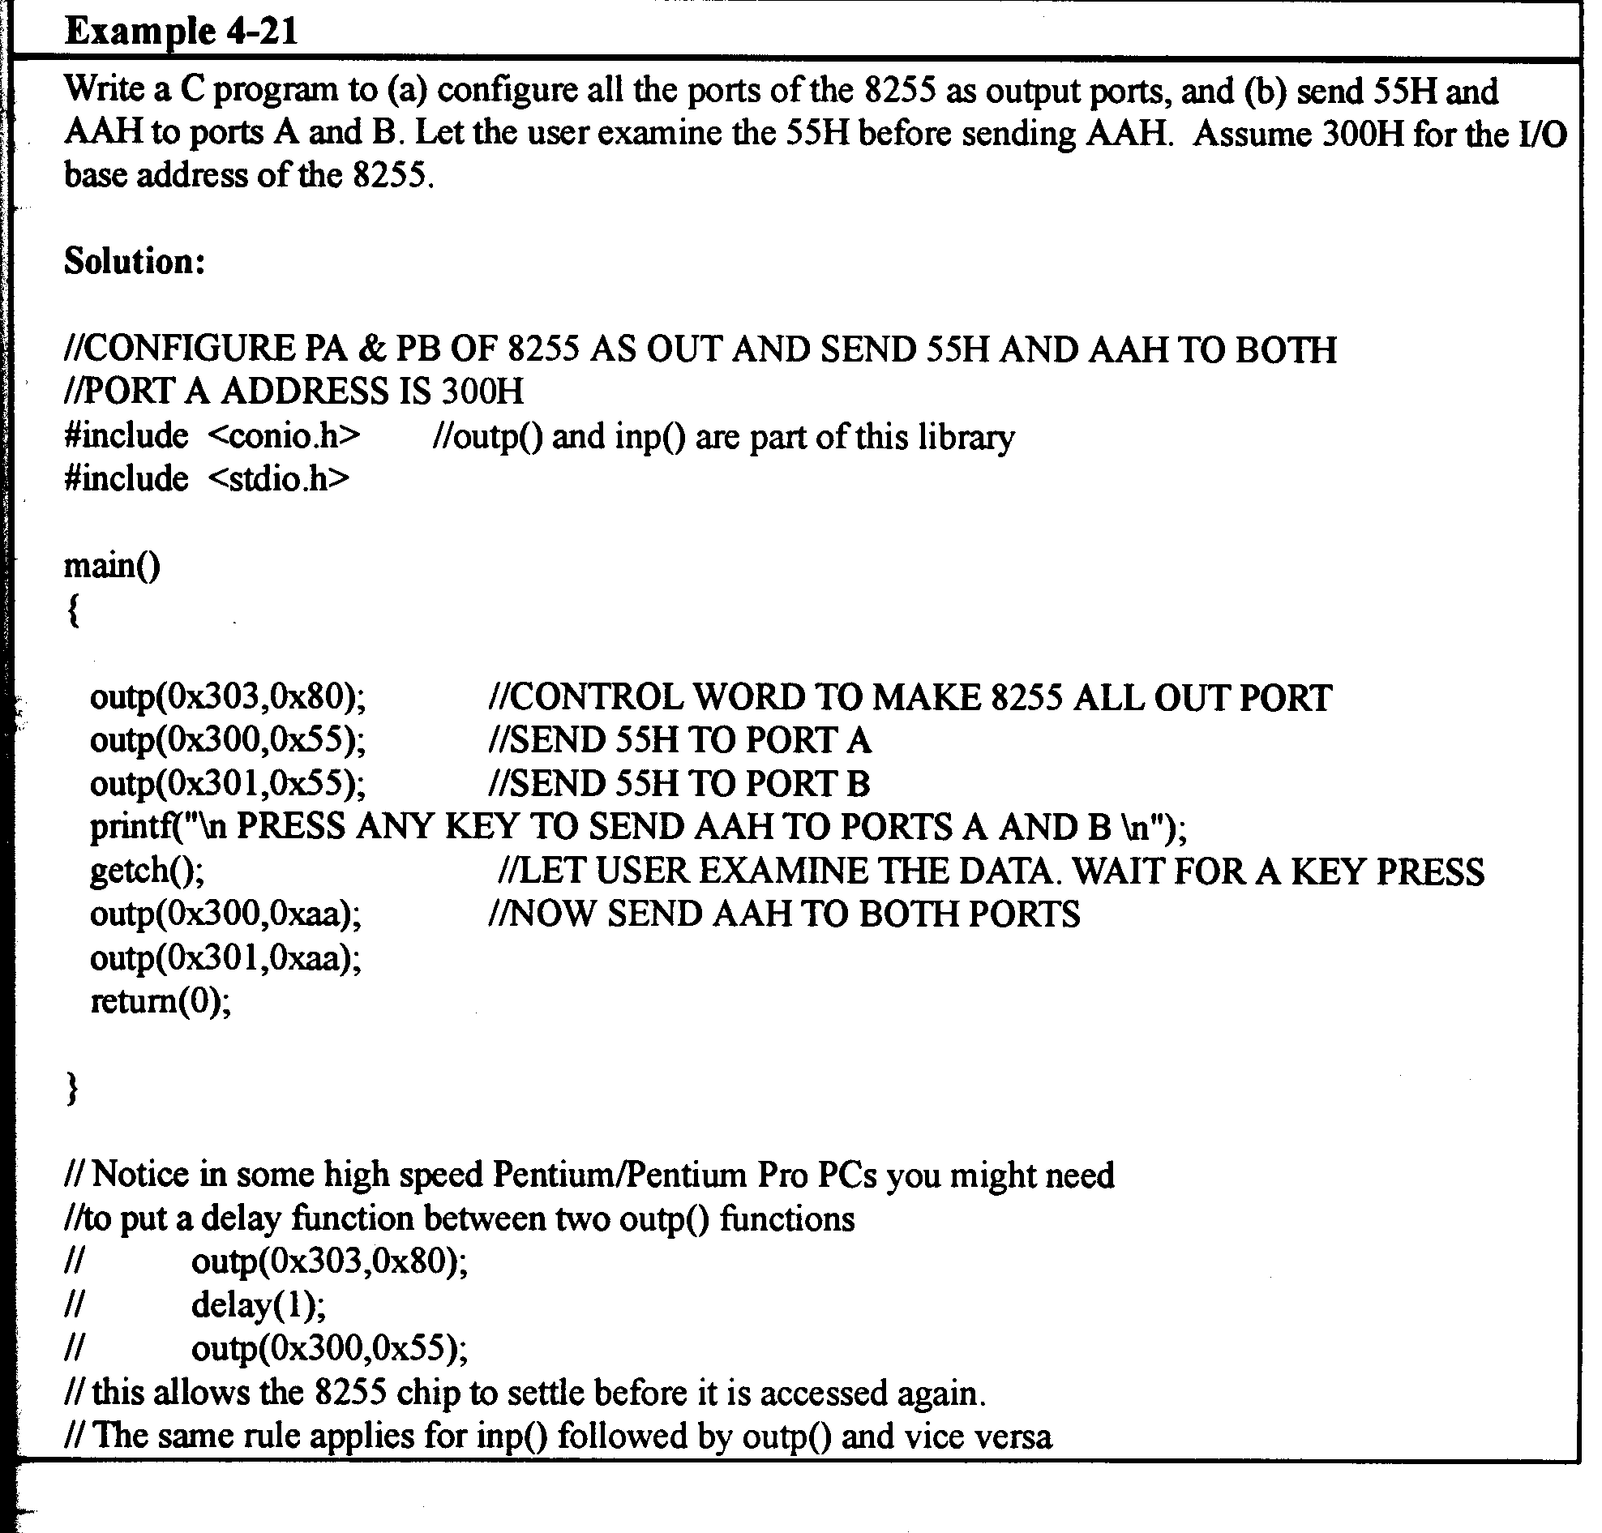
Using C to Program the 8255

Slide 31
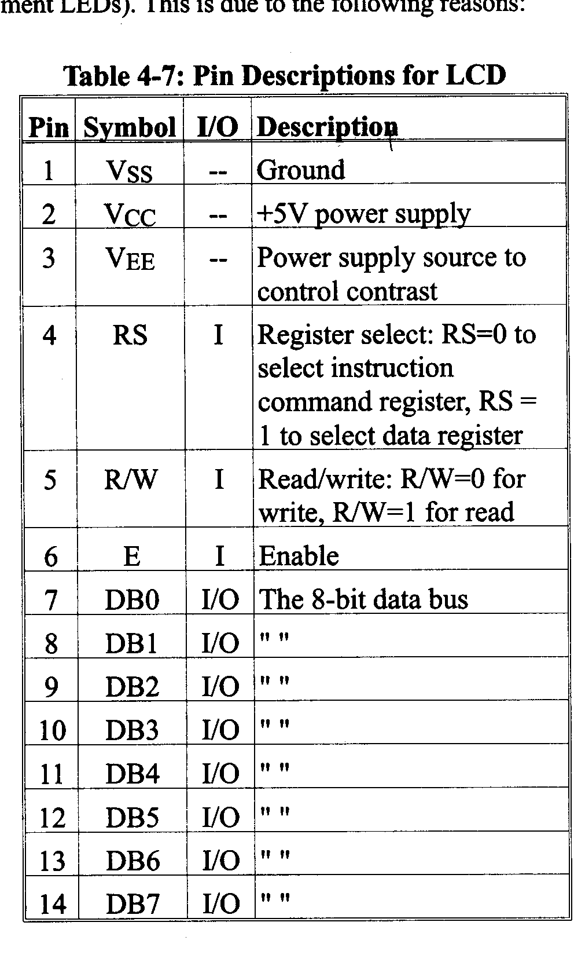
LCD Pinout

Slide 32
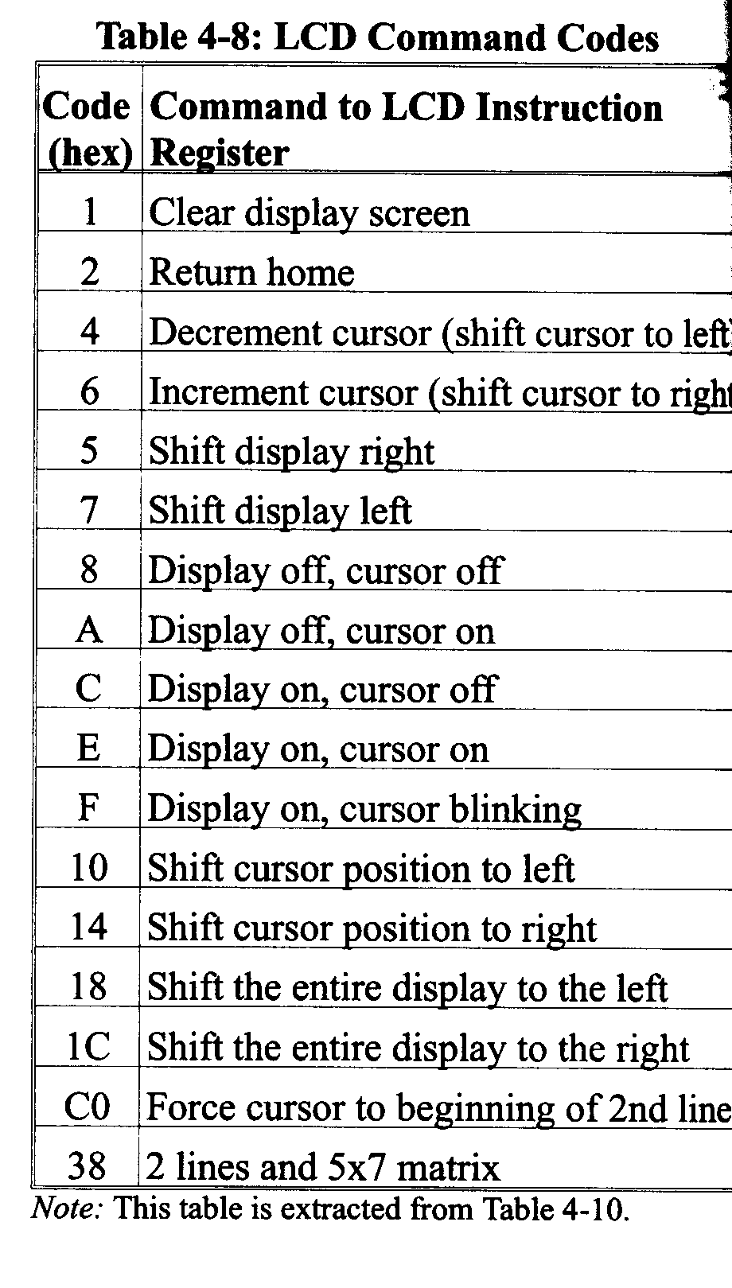
LCD Commands (Partial List)

Slide 33
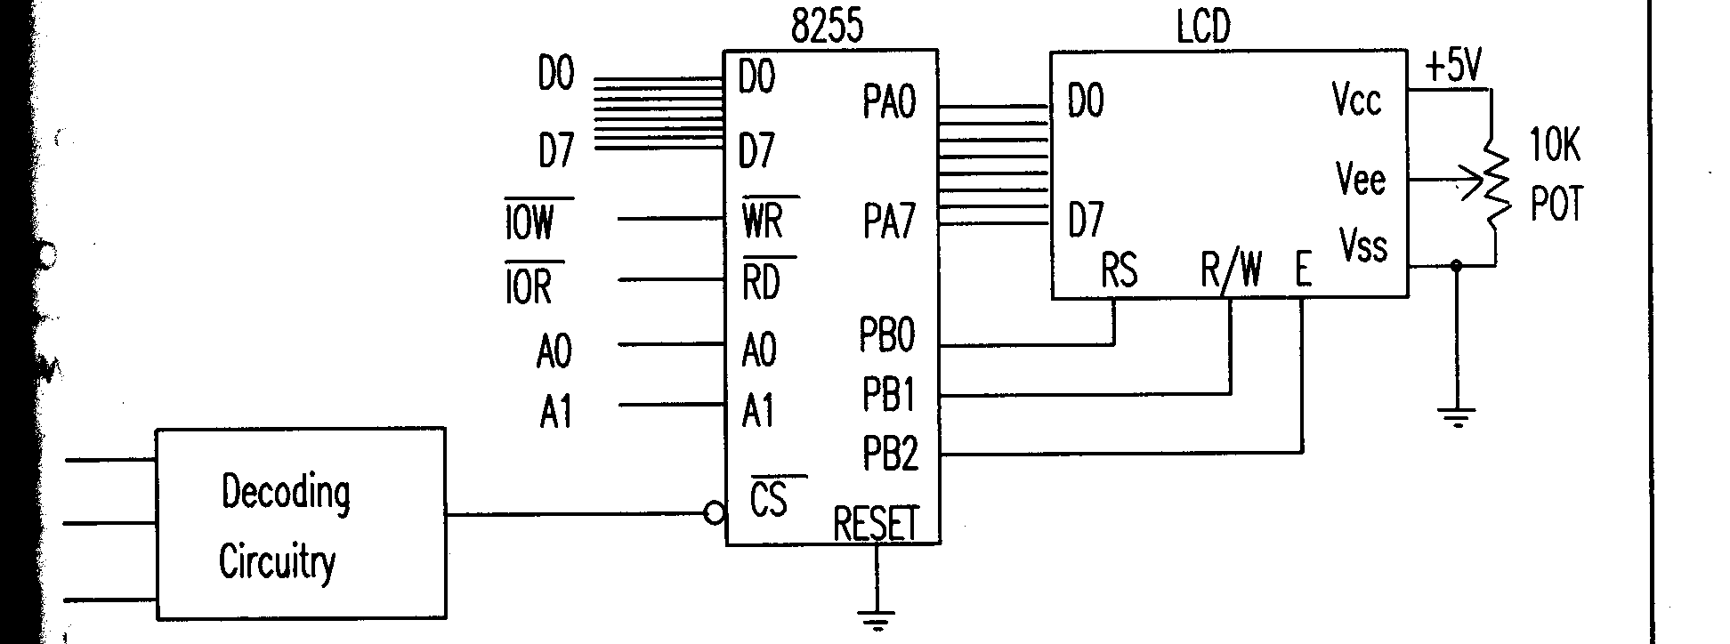
Interfacing LCD Module to PC Using 8255 PPI Chip

Slide 34
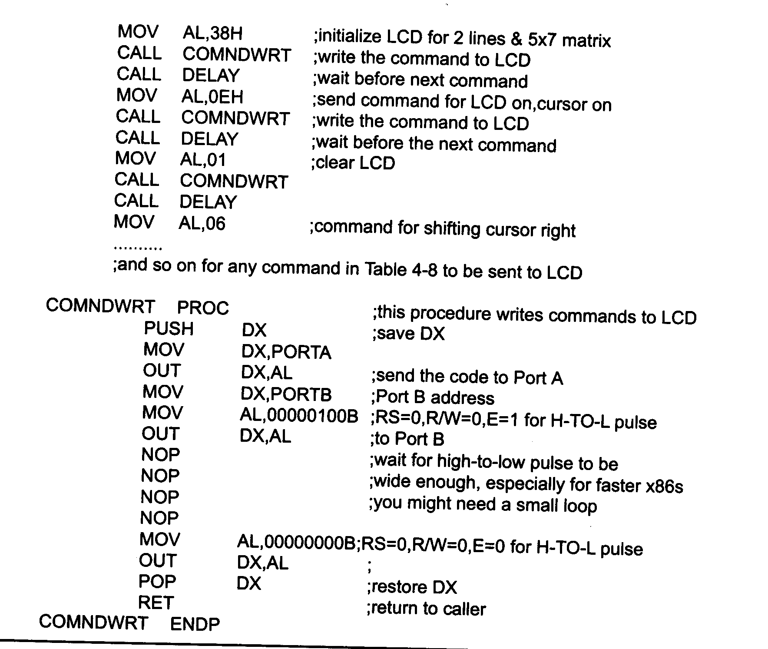
Sending Commands to LCD Module

Slide 35
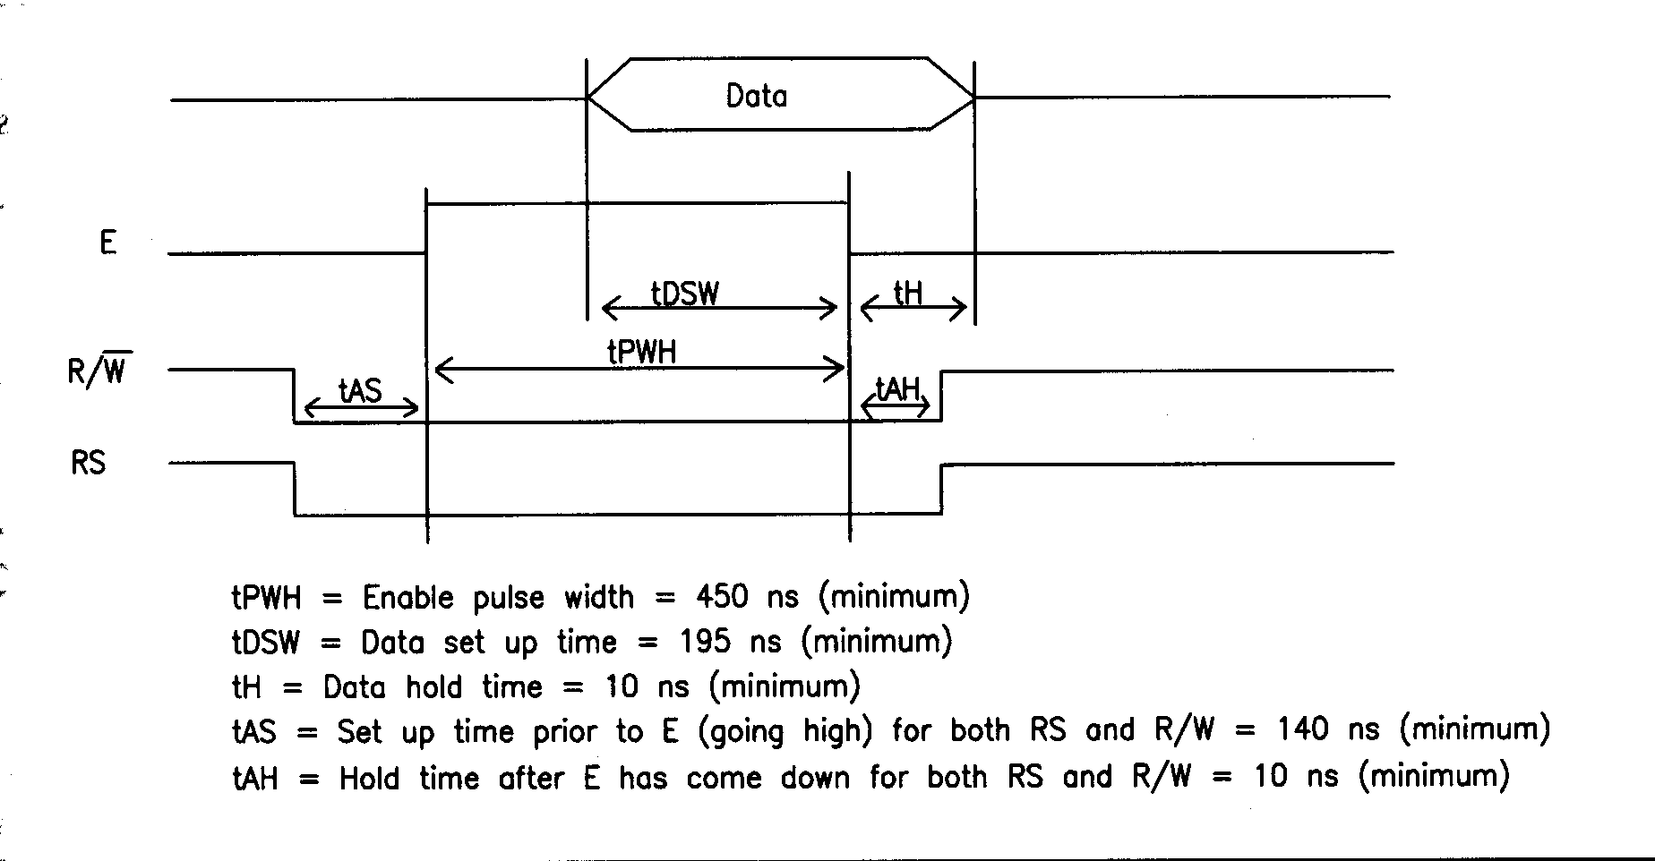
Writing Data and Commands Out to LCD Module (Timing Diagram)

Slide 36
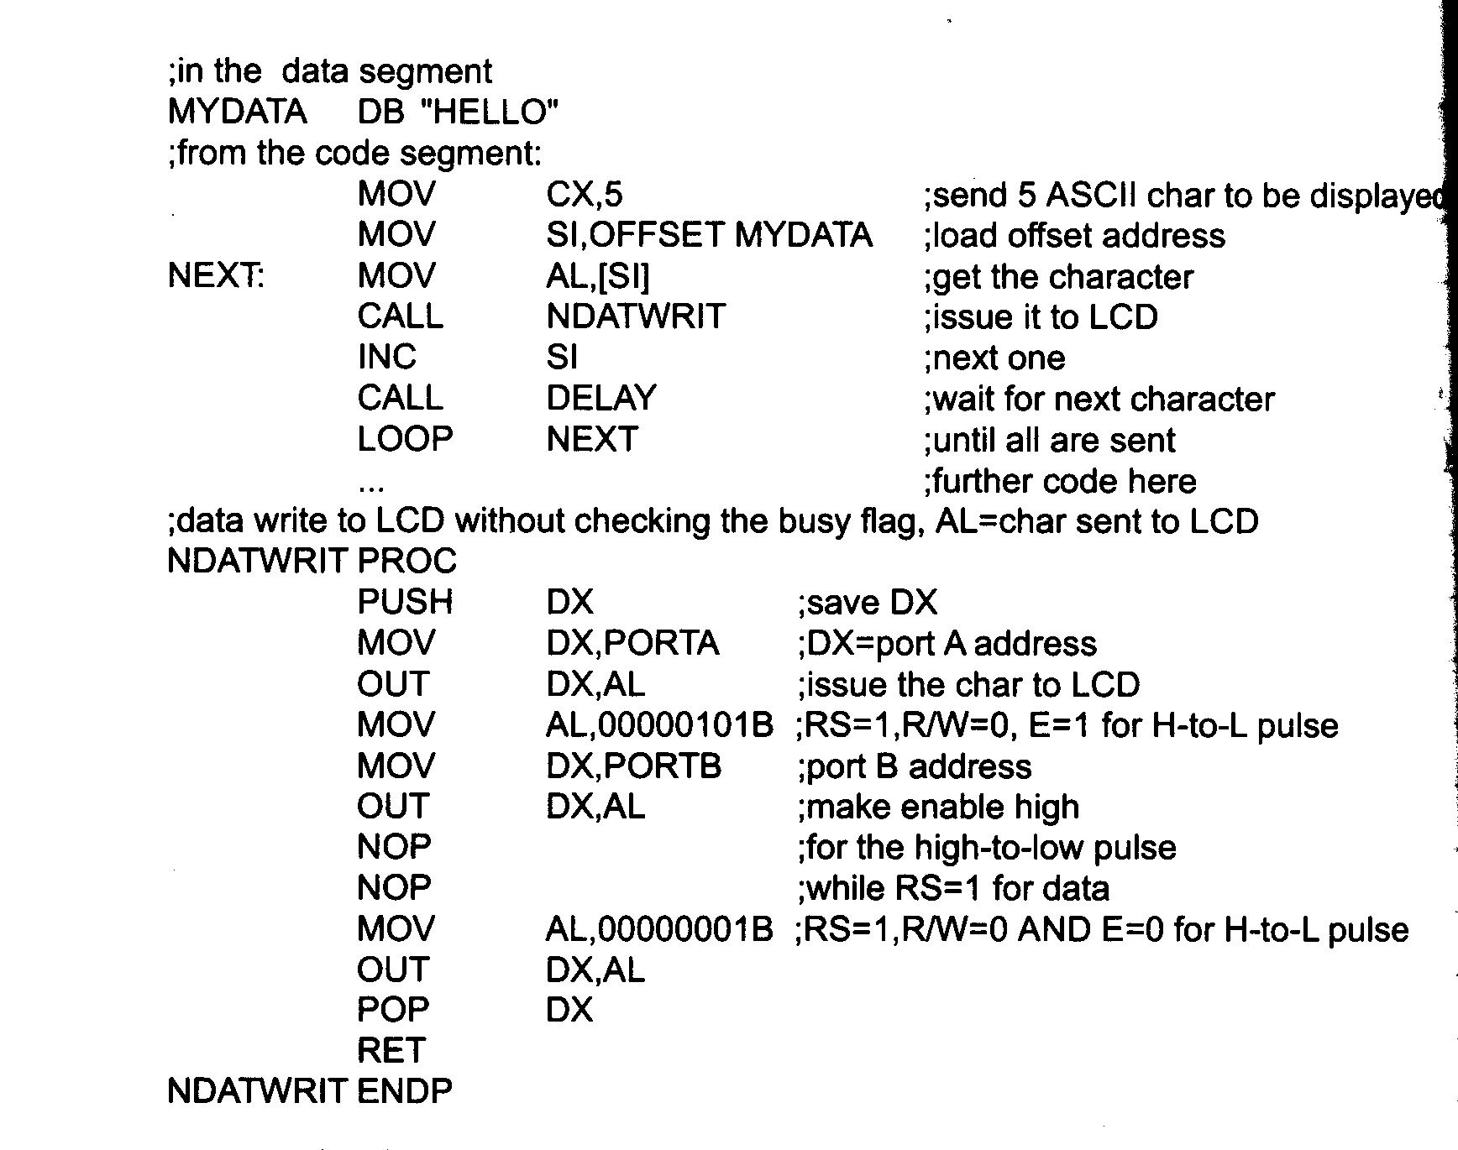
Sending Data to the LCD Module

Slide 37
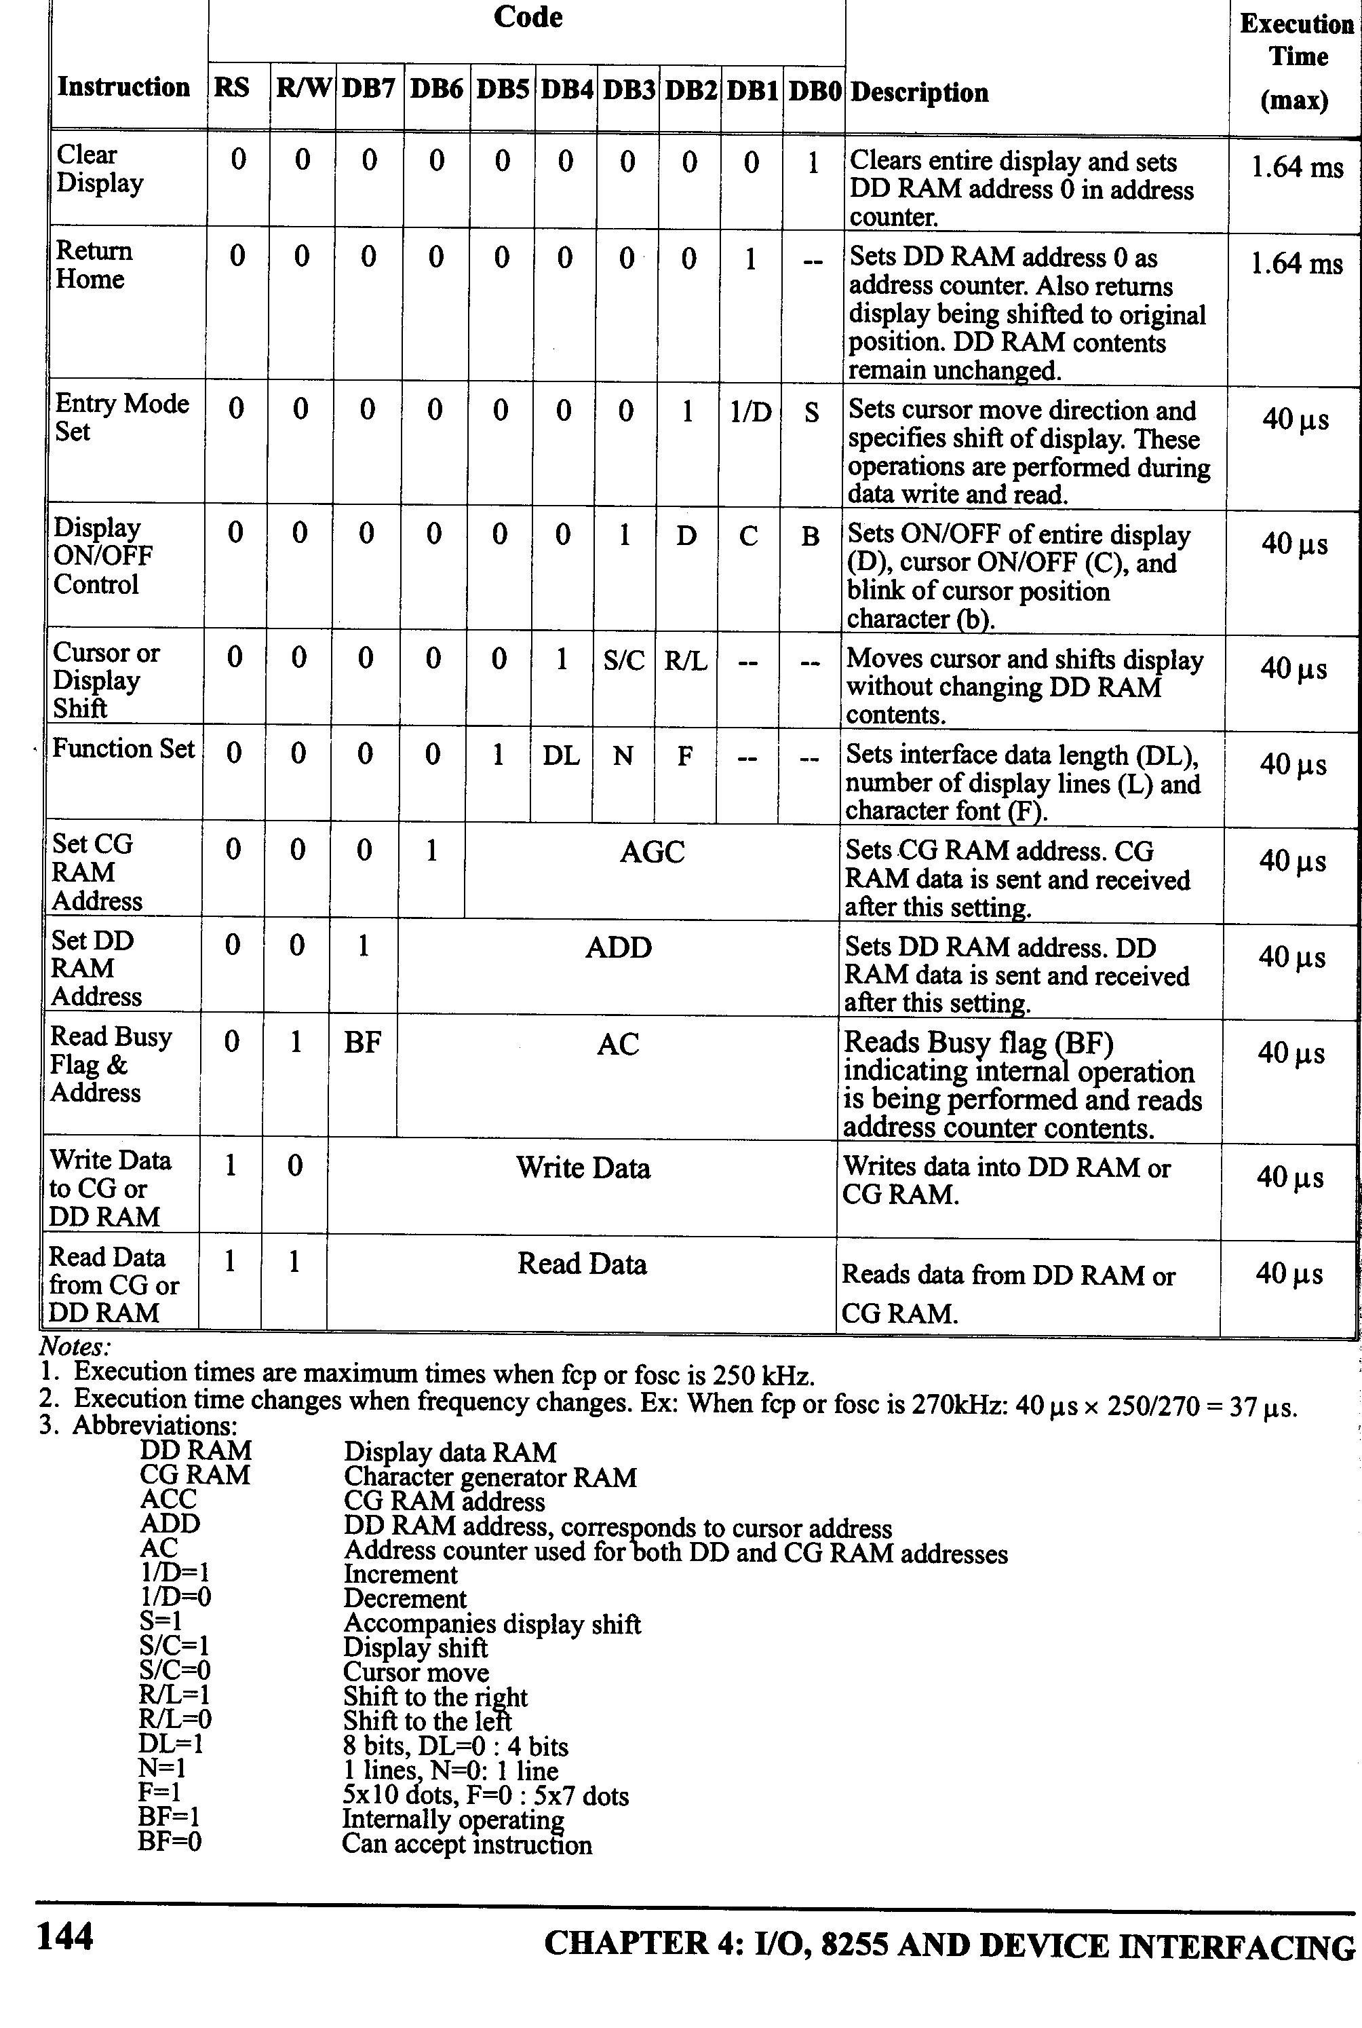
Full Listing of LCD Module Commands

Slide 38
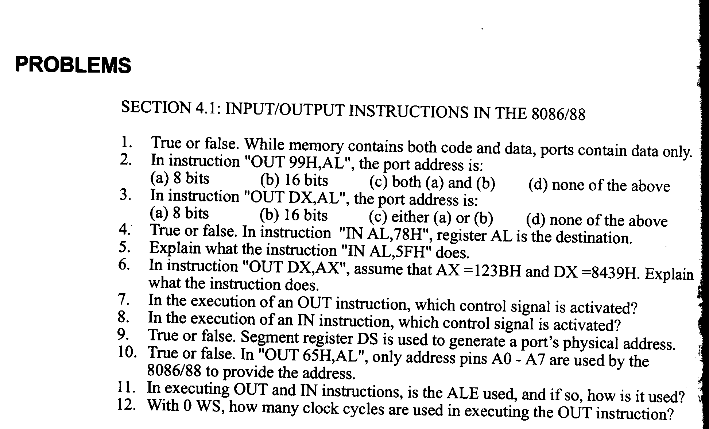
Section 4.1 Problems

Slide 39
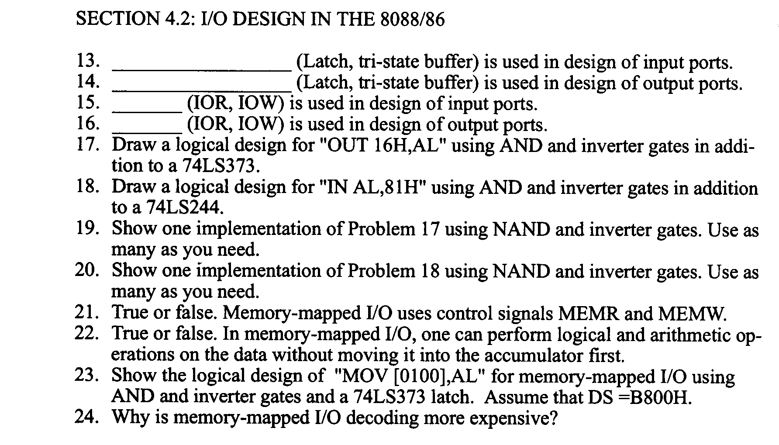
Section 4.2 Problems

Slide 40
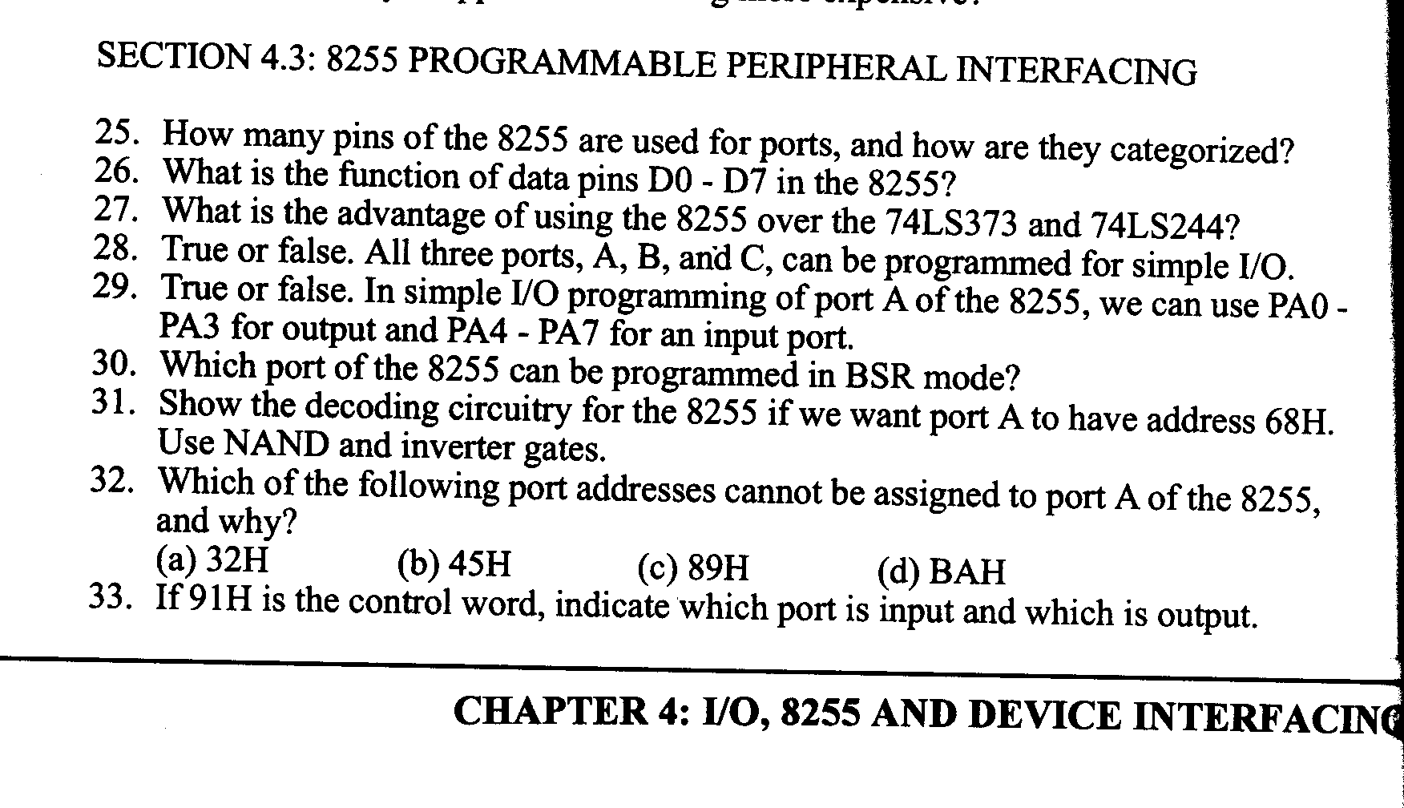
Section 4.3 Problems

Slide 41
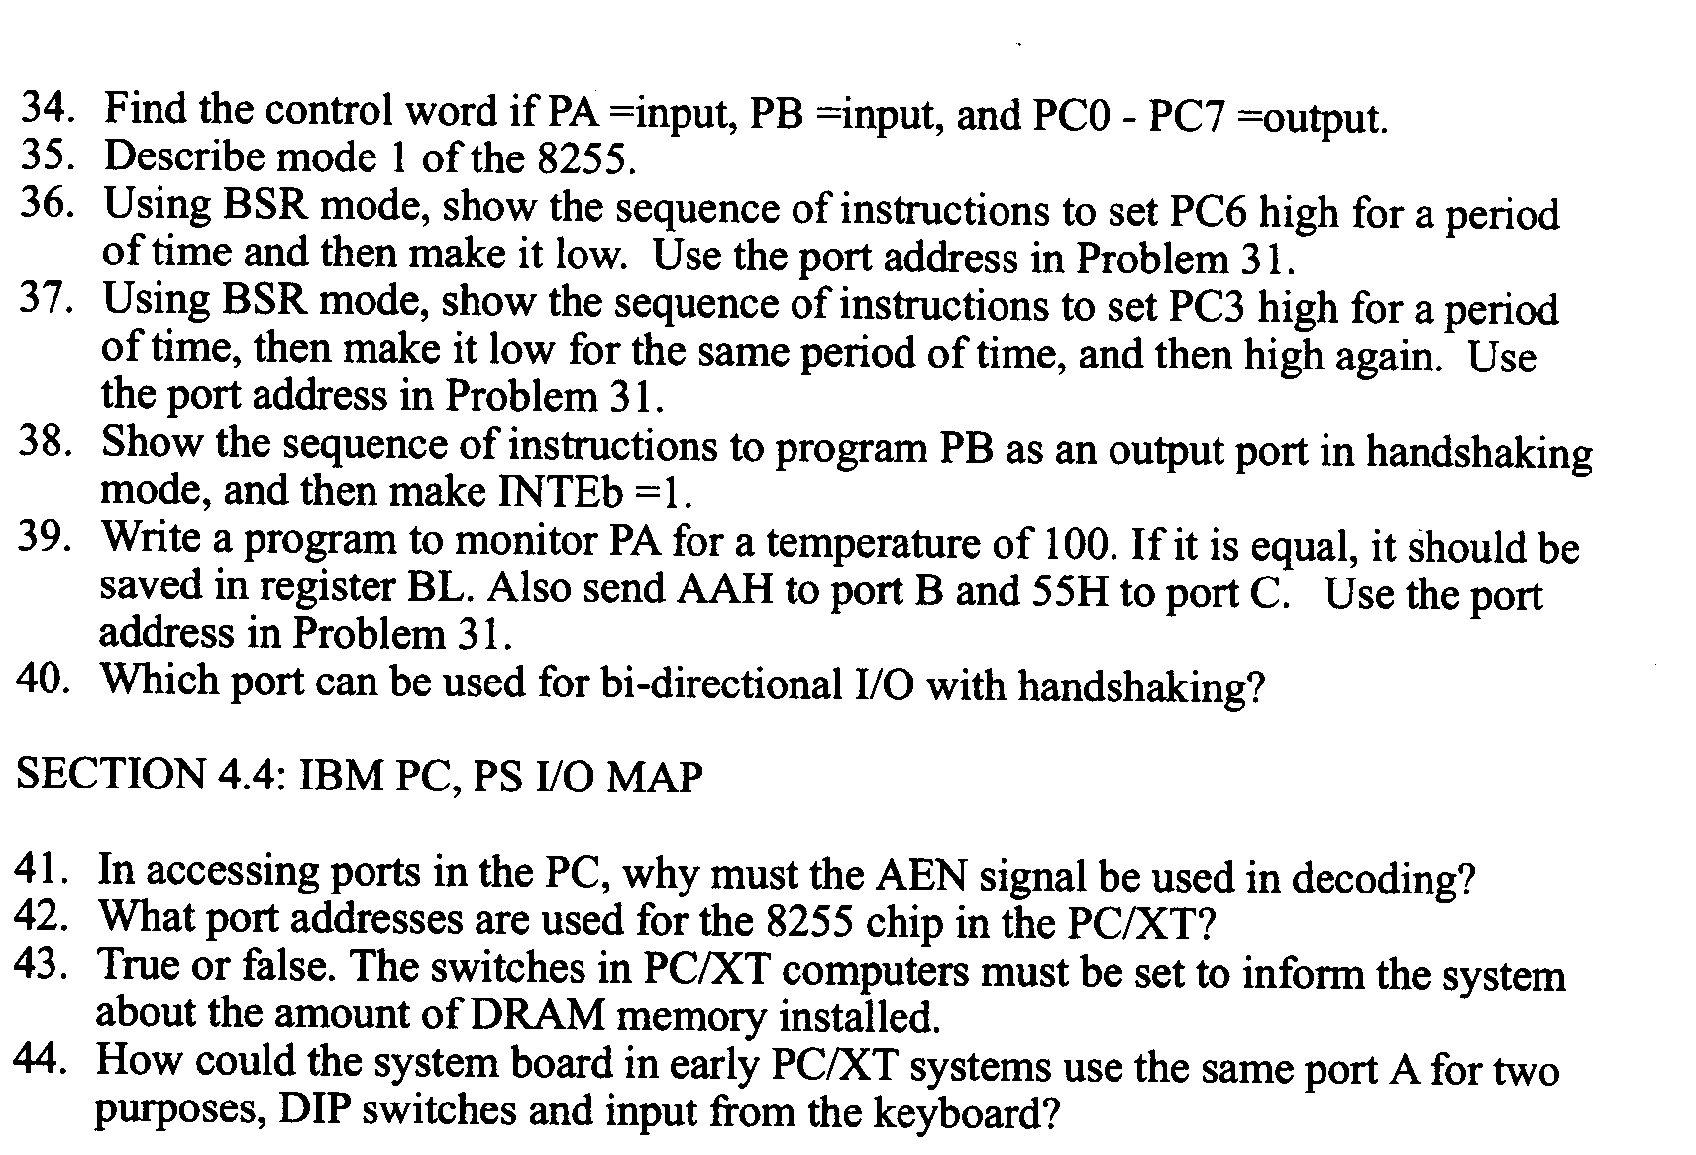
Section 4.4 Problems

Slide 42
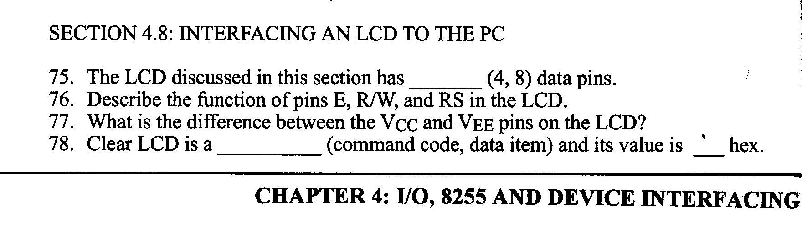
Section 4.8 Problems

Slide 43
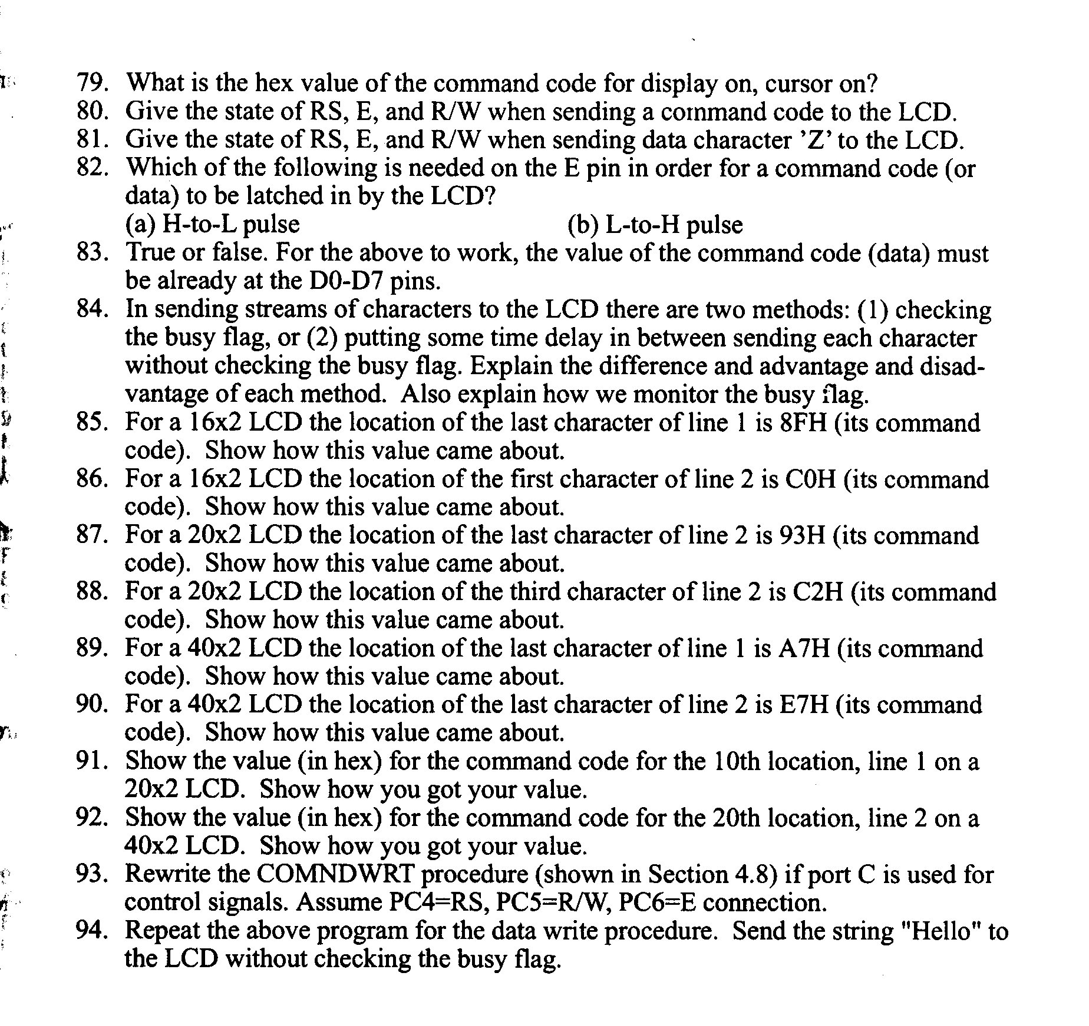
Section 4.8 Problems (Continued)

Slide 44
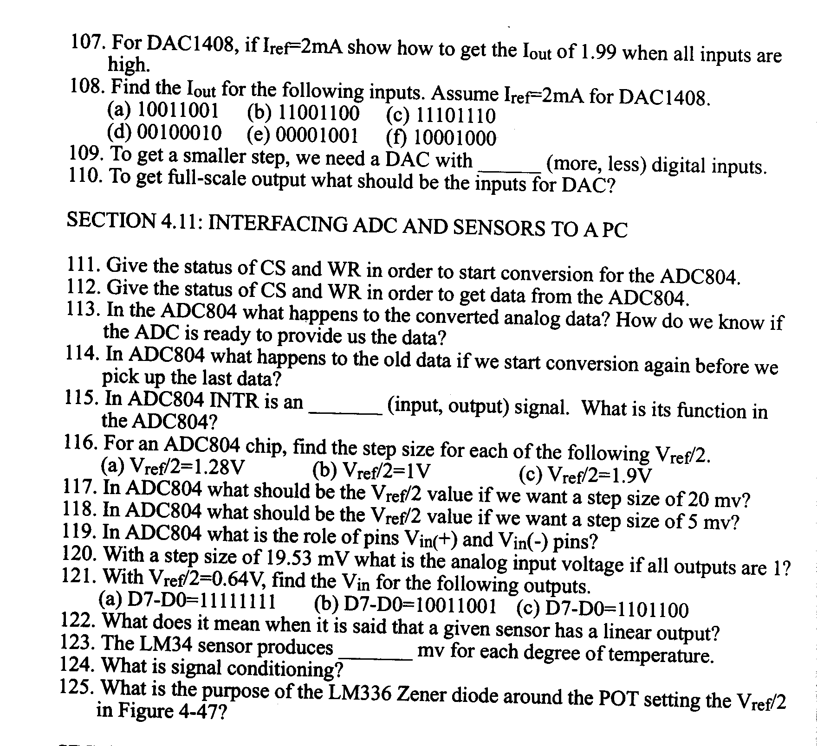
Section 4.11 Problems

